Slide 1


Advance Analog and Mixed Signal Design
Lecture 12
Design Insights of Low-Dropout (Analog & Digital)
Dr. Neeraj Mishra
High Performance Electronics Lab
Electrical & Electronics Eng. Dept.
Birla Institute of Technology & Science Pilani, Pilani Campus

Slide 2
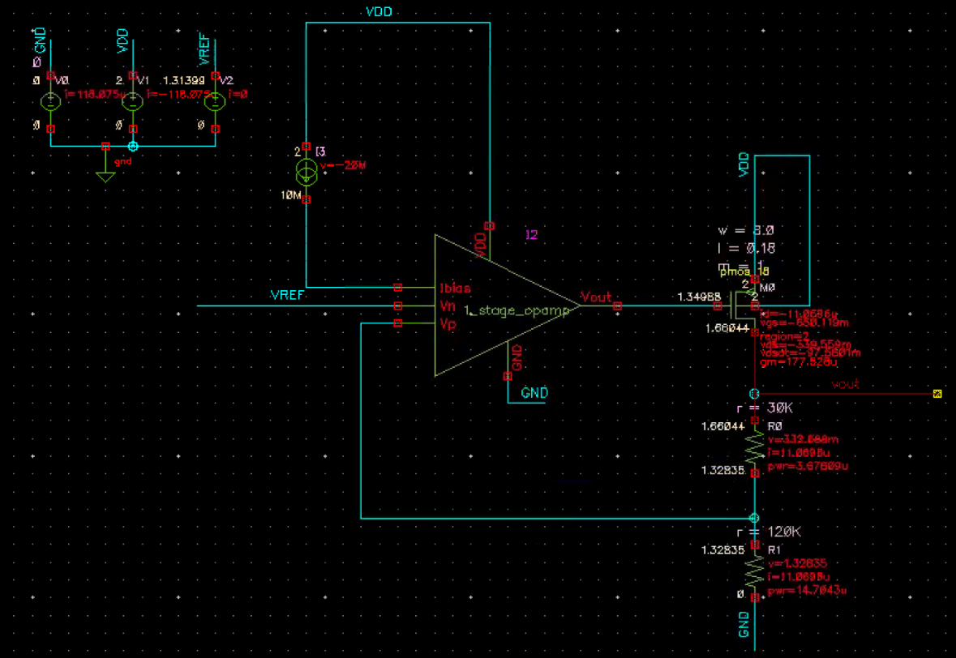
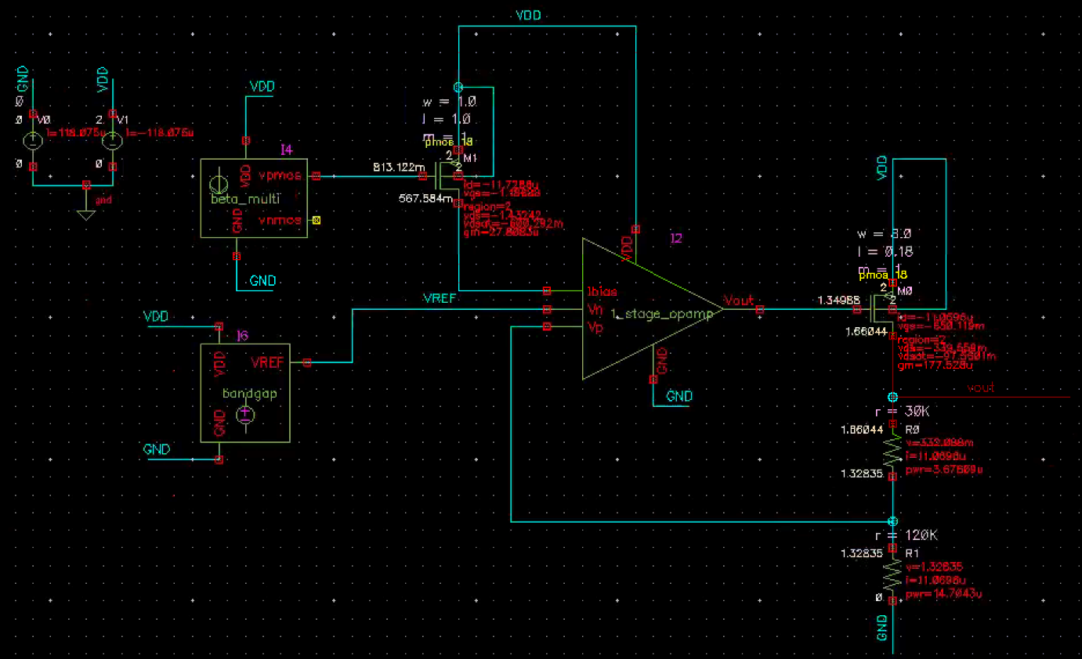
Introduction to design Insights of LDOs
Low-dropout regulator (LDO) - is a critical building block that generates
  A stable voltage (which can be used as a voltage reference or a supply) irrespective of the external conditions (supply voltage variation, noise etc.).
  An LDO helps in achieving better performance of the internal circuits and usually used together with the bandgap reference to ensure a constant output voltage.

Slide 3
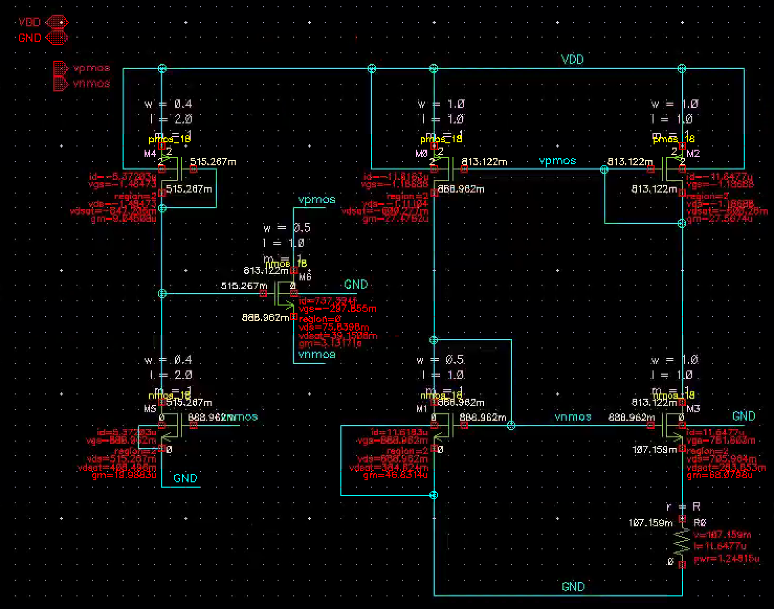
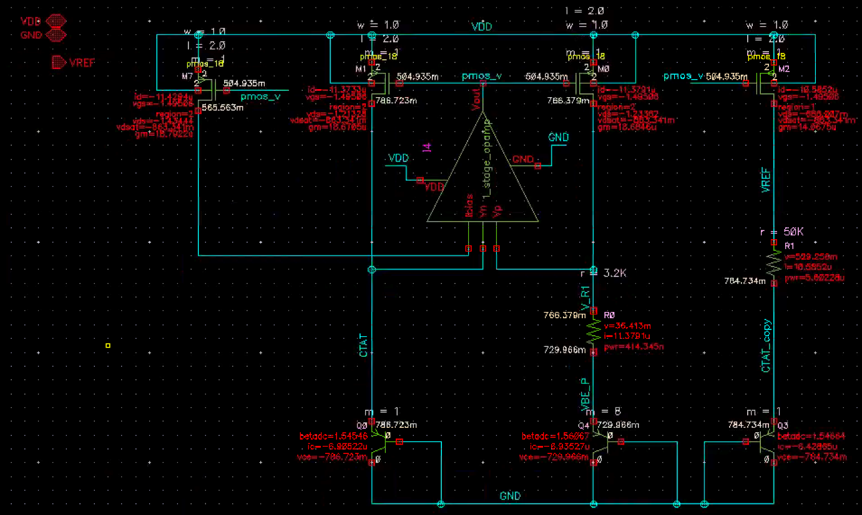
Cont..

Slide 4
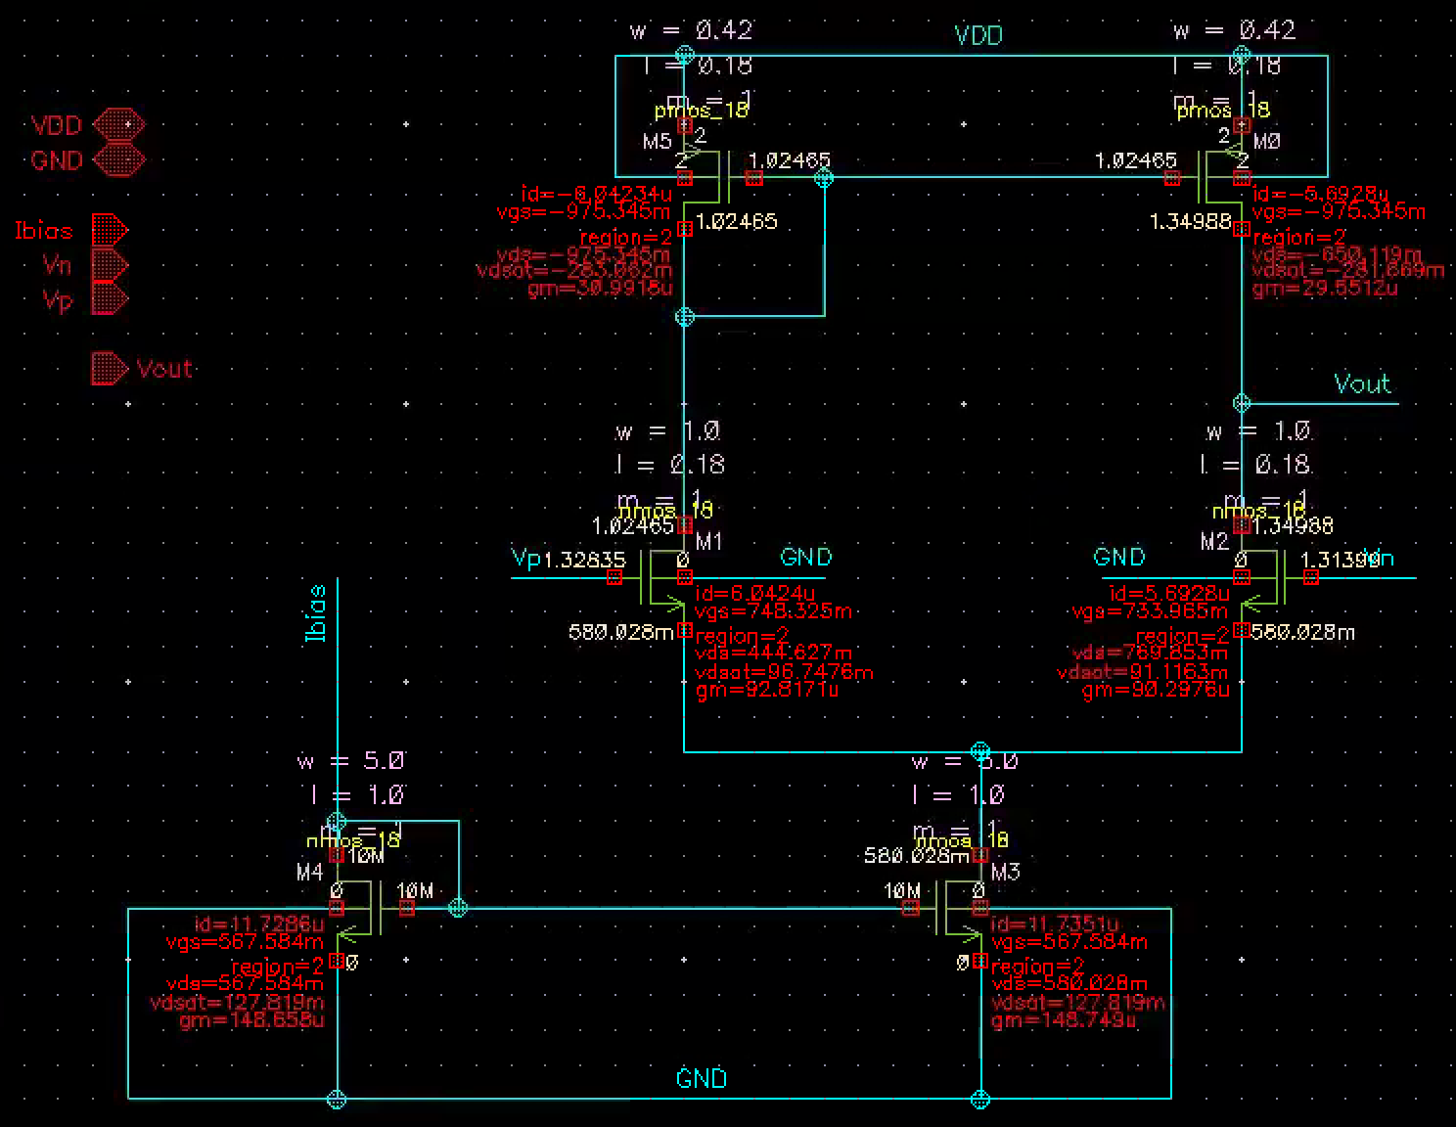
Cont..

Slide 5
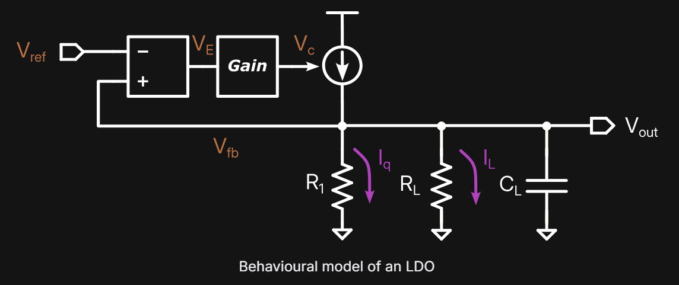
Principle of operation
error voltage
The principle of operation of an LDO can be explained as a voltage-controlled voltage source (VCVS). This VCVS is controlled by two voltages
  Reference voltage (V_{ref})
  feedback voltage (V_{fb})
It targeting to maintain a constant voltage (V_{out}) equal to V_{ref} by supplying sufficient current to the feedback resistance R₁​ and load resistance R_{L}​.
reference voltage
control voltage
VCVS
constant voltage
subtraction block
quiescent current
feedback voltage
The feedback resistance R₁​ defines a minimum current at no-load condition which is called quiescent current (I_{q}). Elaborating further the control stage of an LDO, we can represent it as a subtraction block, producing the error voltage V_{E} followed by the gain stage, generating the control voltage V_{c} :

Slide 6
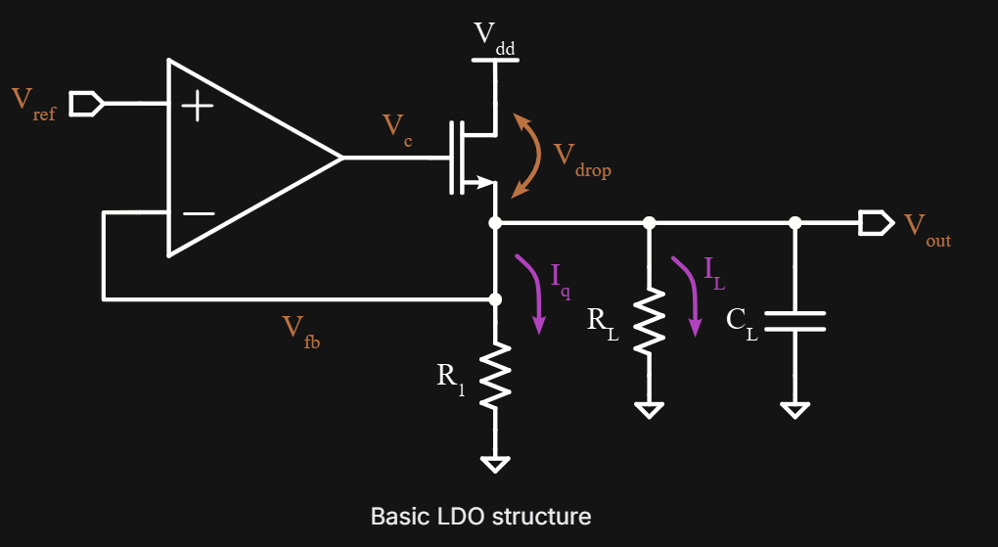
Cont..
Subtraction and gain
How it work
Subtraction and gain can be implemented using OTA and usually called an error amplifier.
The voltage controlled current source is represented by the MOS transistor and usually called a pass device:
voltage controlled current source
OTA
pass device
error amplifier

Slide 7
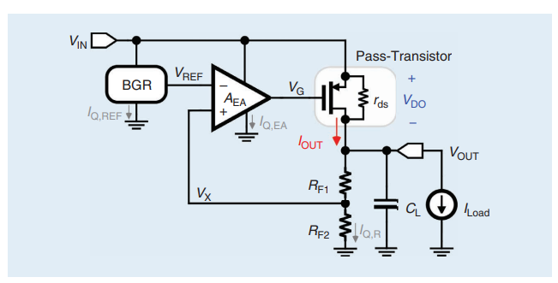
Real LDOs

Slide 8
Cont..
Subtraction and gain
The difference between
The feedback voltage V_{fb​} and the reference voltage V_{ref} produces the control voltage V_{c​} which determines current through the pass device,
It ensuring that enough current is supplied to the load resistance R_{L}​ and V_{out​} = V_{ref​} is maintained.
The load capacitance C_{L​} is playing a vital role during load transients (by supplying extra current) and stability, which will be discussed later.
voltage controlled current source
OTA
pass device
error amplifier

Slide 9
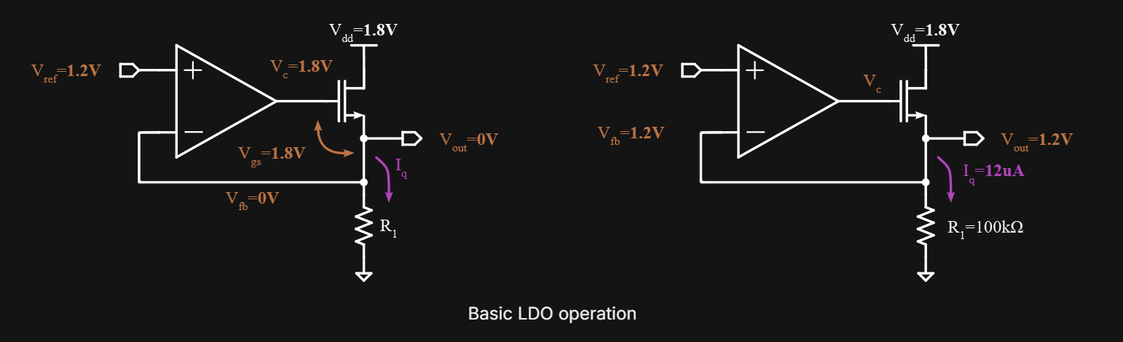
Practical example of an LDO
Let's have a look on a practical example of an LDO to understand its operation better. The picture below represents a simple LDO with an NMOS pass device and no load.
NMOS pass device
No load

Slide 10
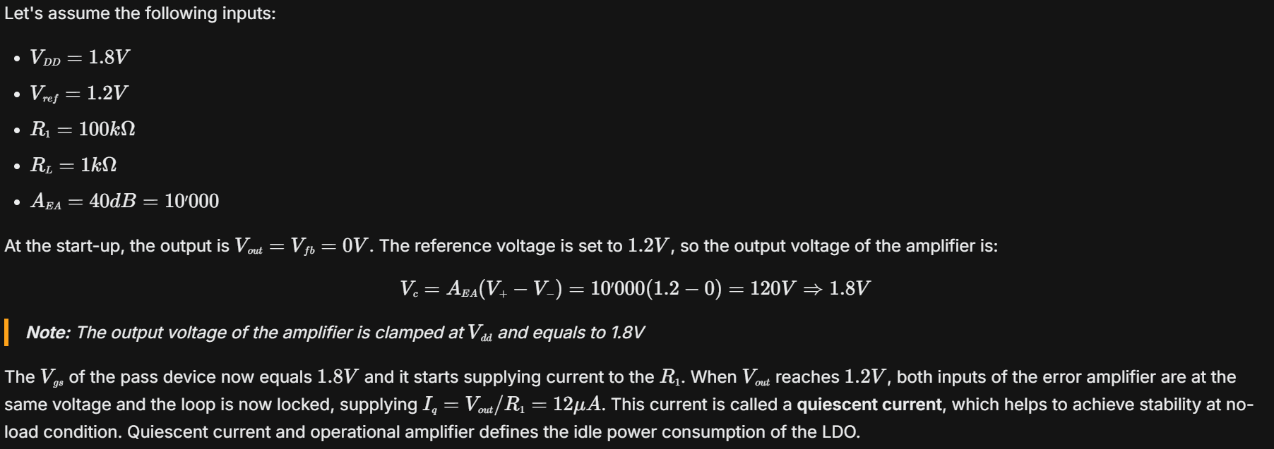
Cont..

Slide 11
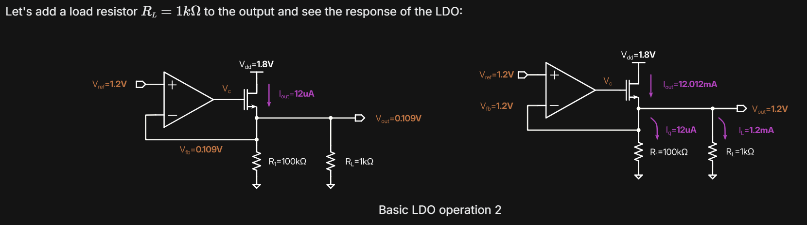
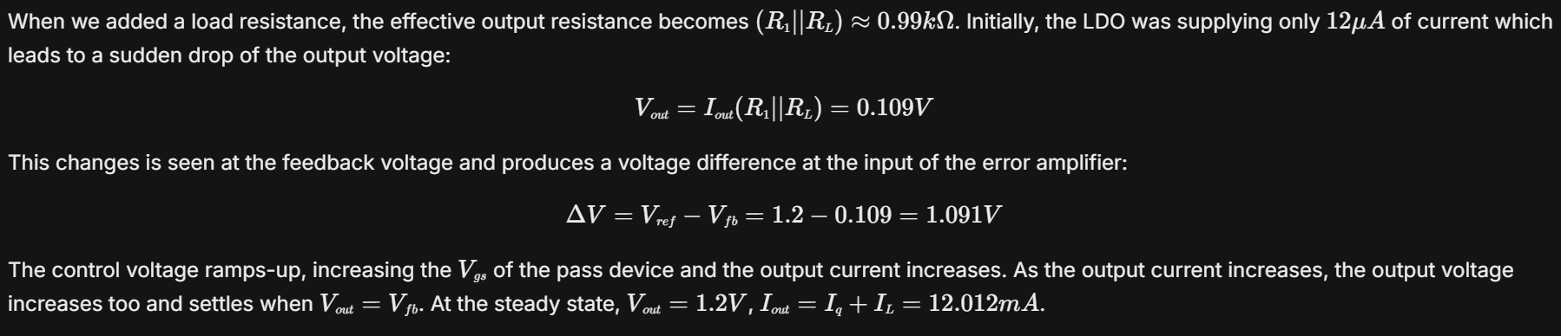
LDO operation under load

Slide 12
LDO topologies
LDOs have a variety of topologies and oriented for use with analog or digital circuits. There are two main LDO topologies: NMOS- and PMOS- based.
By architecture:
  With an off-chip load capacitor
  Capacitor-less
By Pass device type:
  NMOS-based
  PMOS-based

Slide 13
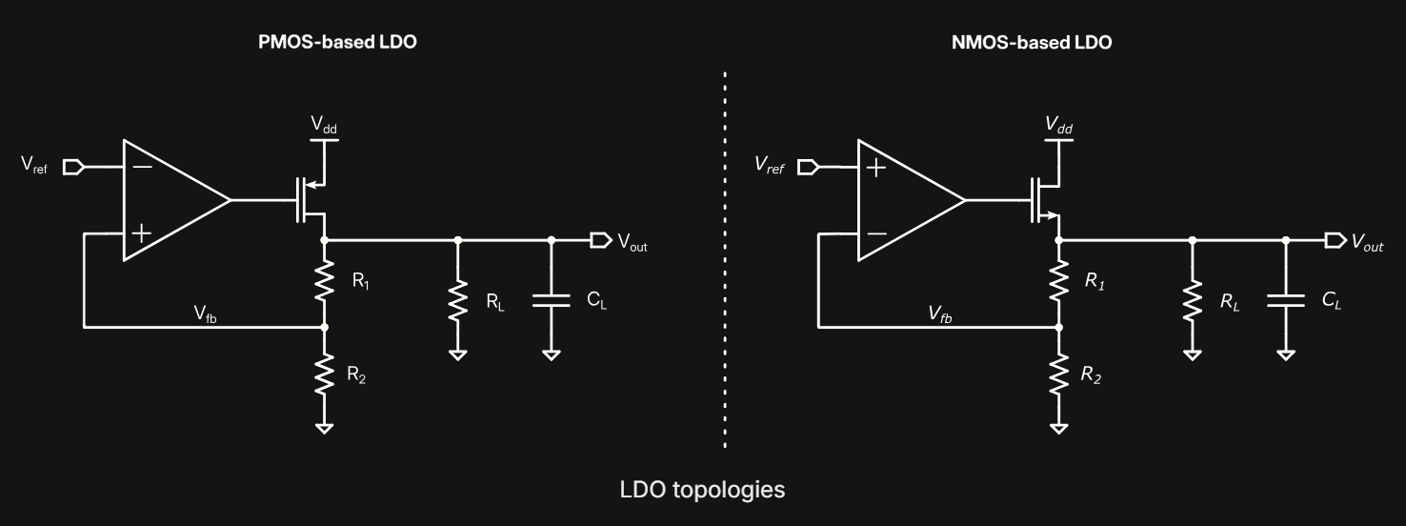
PMOS V/S NMOS LDOs
PMOS-based
NMOS-based

Slide 14
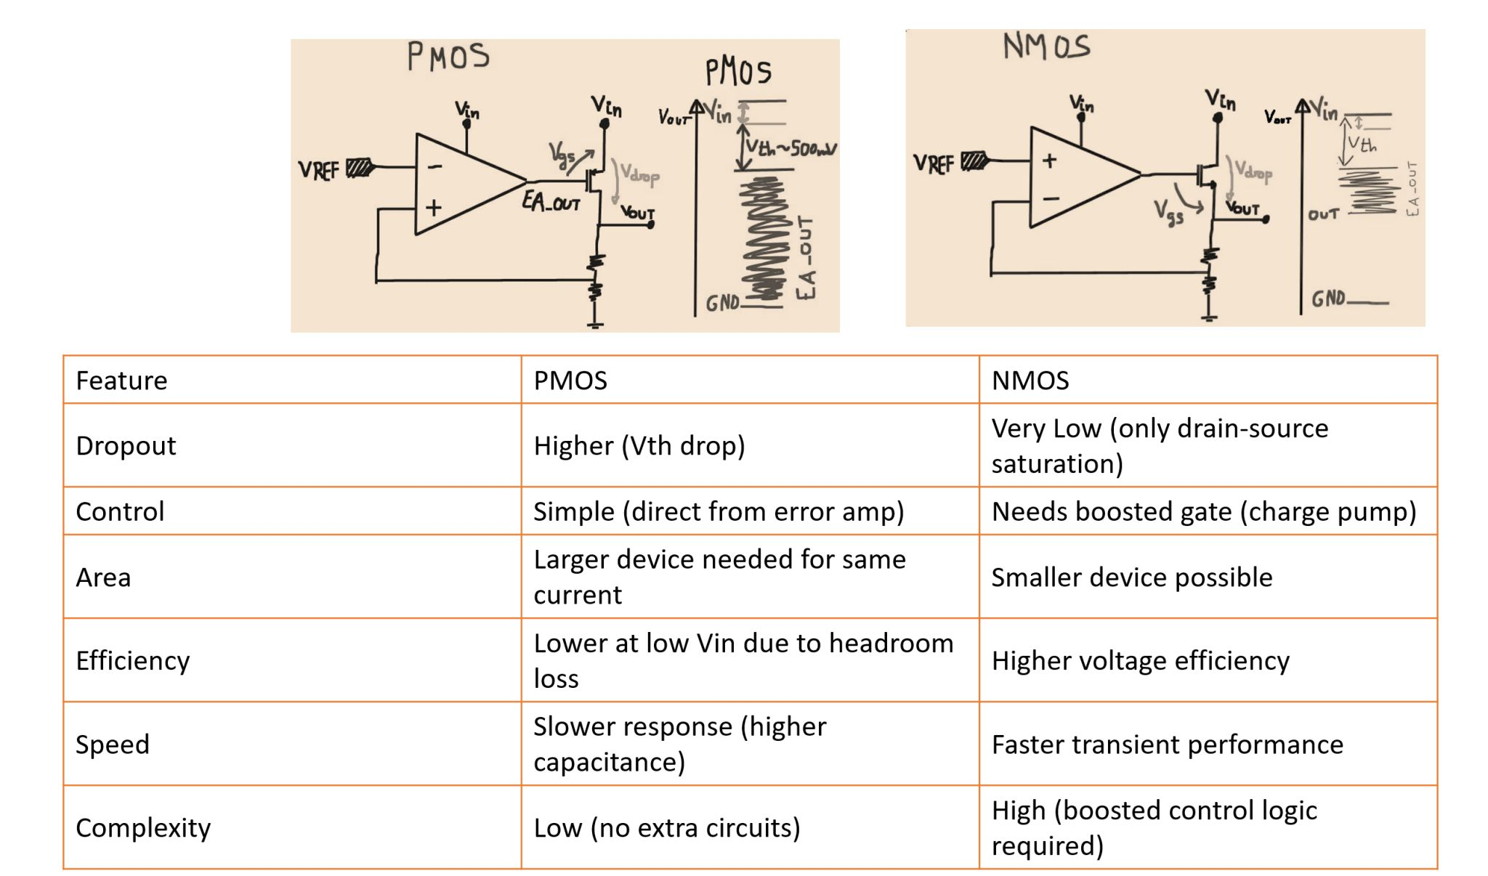
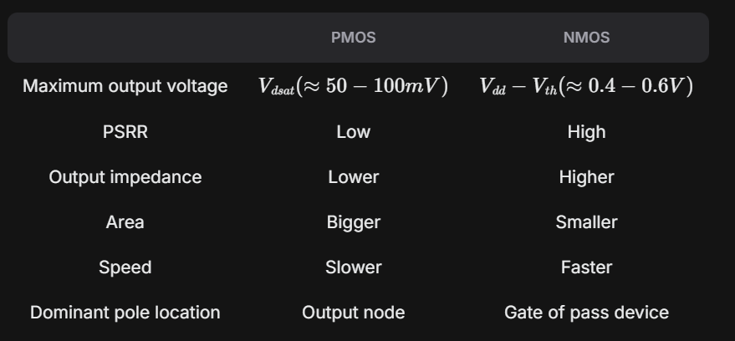
PMOS V/S NMOS LDOs
A bandgap voltage reference provides a stable reference signal for the regulator.
  An error amplifier (EA), typically implemented as an OTA (Operational Transconductance Amplifier), detects differences between the feedback voltage and the reference voltage, adjusting the pass-element resistance accordingly.
  A feedback resistor network divides the output voltage for comparison with the reference voltage (V_{ref​}). The pass device (usually a MOSFET) regulates resistance between the input and output voltages to maintain stability.
  In practical applications, the pass device is commonly a PMOS transistor. Next, we’ll compare the use of PMOS vs. NMOS topologies:

Slide 15
PMOS LDOs/NMOS LDOs
PMOS LDOs is the most commonly used topology due to their low dropout voltage, while NMOS pass transistors are practical when the supply voltage is significantly higher than the regulated output.
In an NMOS configuration, the pass transistor acts as a common drain (source follower) with positive gain, whereas the PMOS operates as a common source with negative feedback. This difference requires the op-amp polarity to be adapted accordingly.

Slide 16
Advantage
The primary advantage of PMOS LDOs is their lower dropout voltage.
The error amplifier output (EA_{out}​) in a PMOS design can swing between GND and Vin​−Vth​, with dropout voltage primarily dependent on V_{ds}​ (around 50mV for saturated devices).
In contrast, NMOS LDOs require the output of the error amplifier to be at least V_{th}​ above the output voltage to turn on the pass transistor.
This means the output voltage is inherently limited to at least V_{th} below the input voltage, with additional margin for loop regulation.
Furthermore, NMOS pass devices are typically high-power or high-voltage transistors designed to handle significant current and voltage, and their threshold voltage is often higher than the standard 1V of regular transistors.

Slide 17
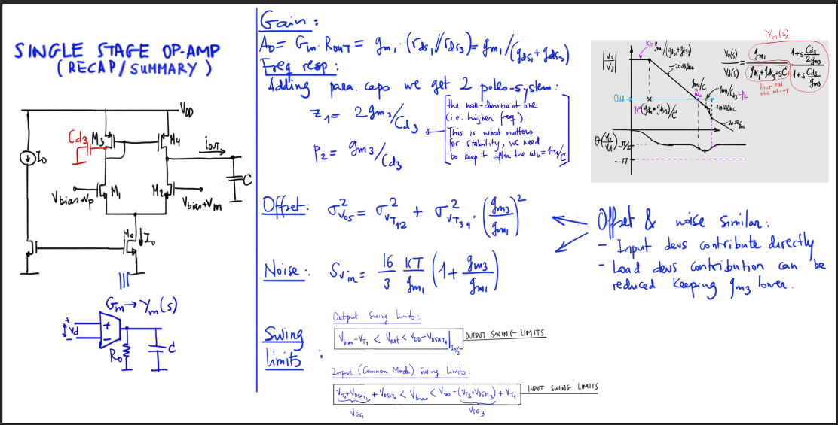
Single Stage OTAs

Slide 18
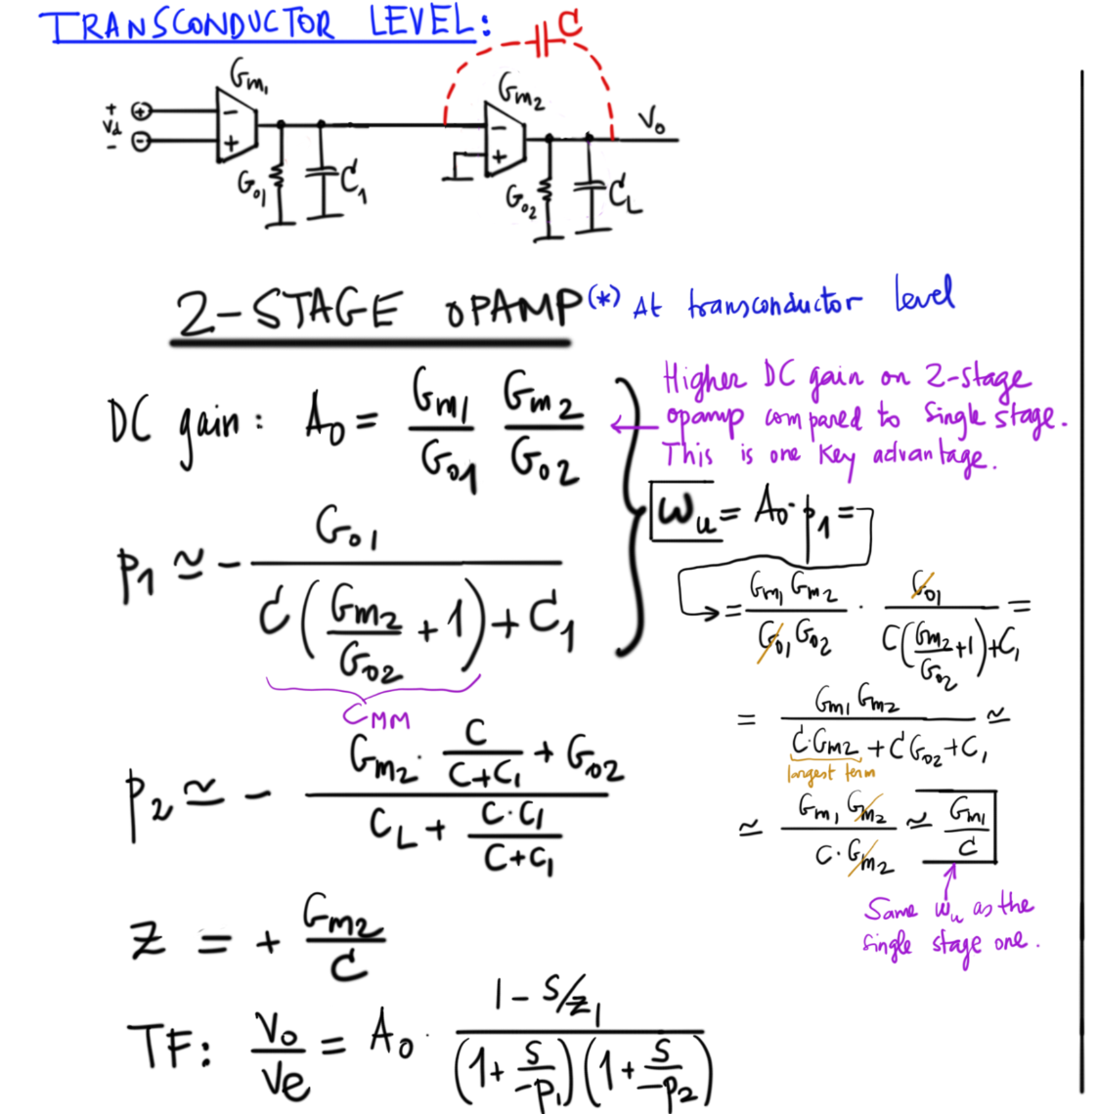

Slide 19
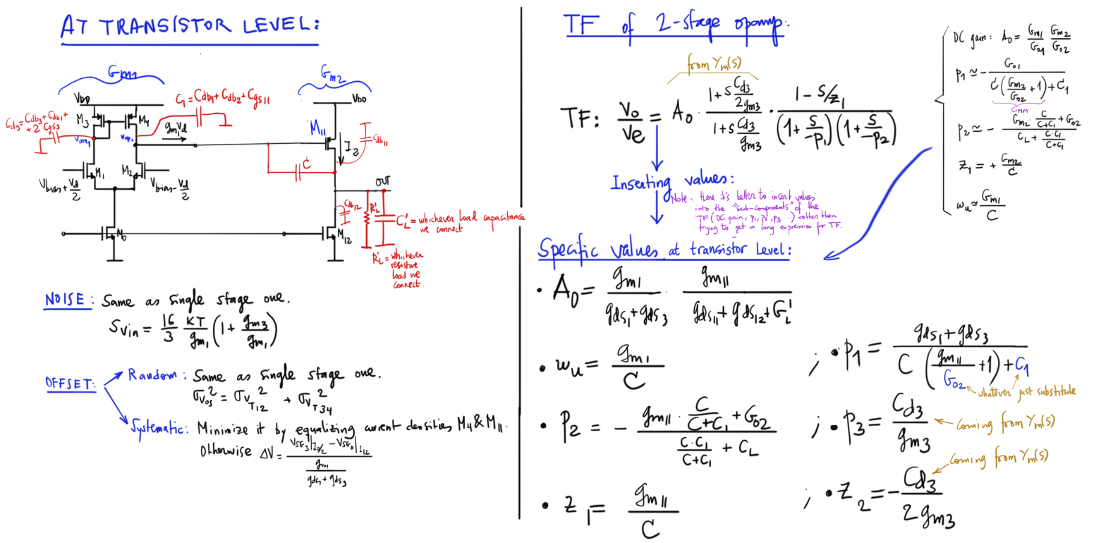
2 Stage or Millar OTAs

Slide 20
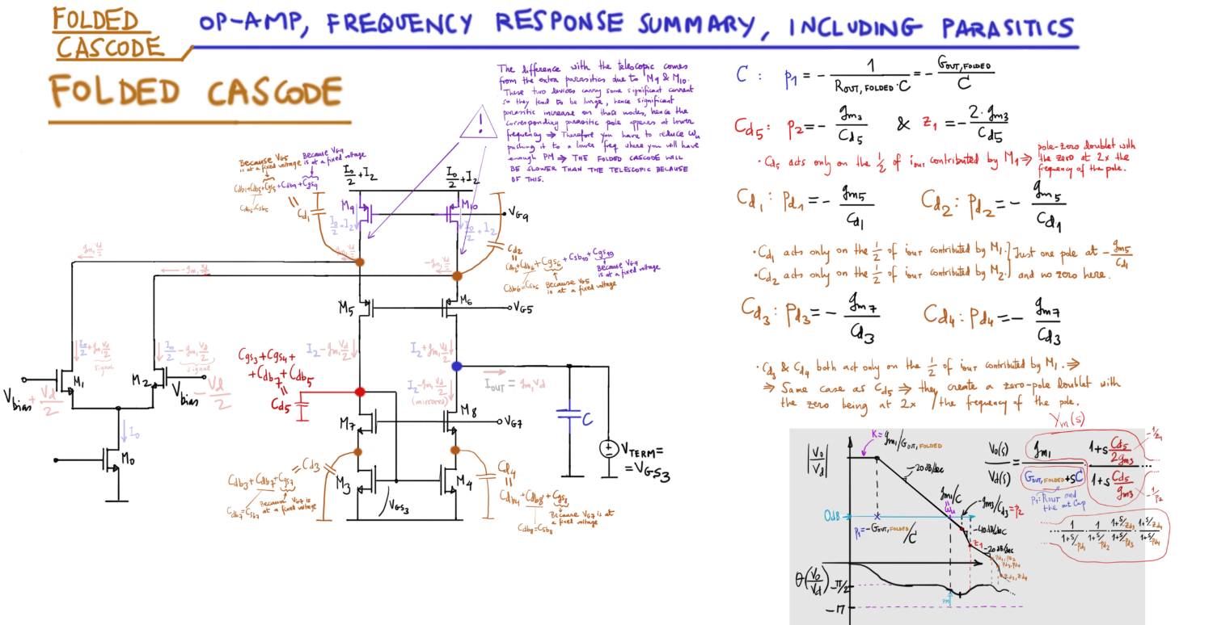
Folded Cascode OTAs

Slide 21
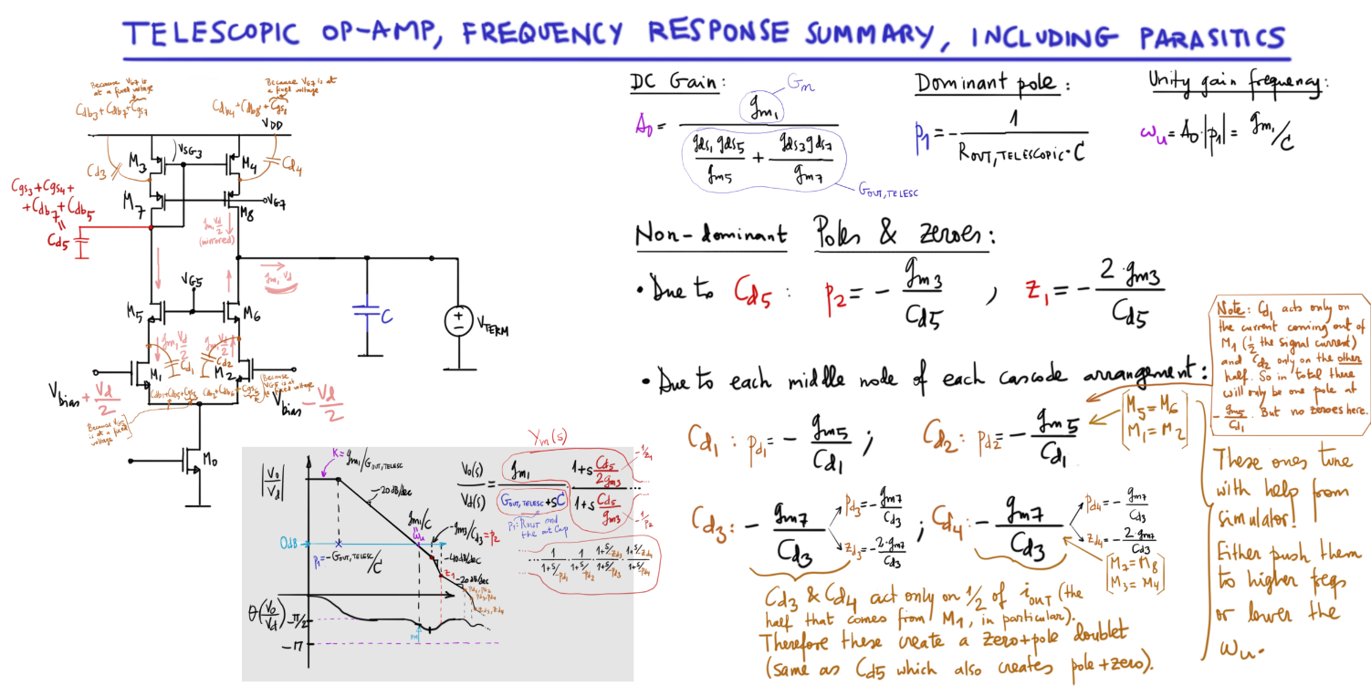
Telescopic OP AMP/OTAs

Slide 22
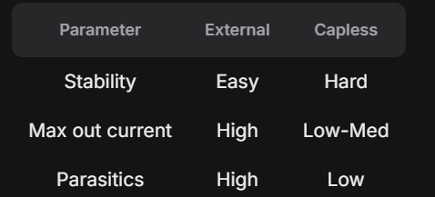
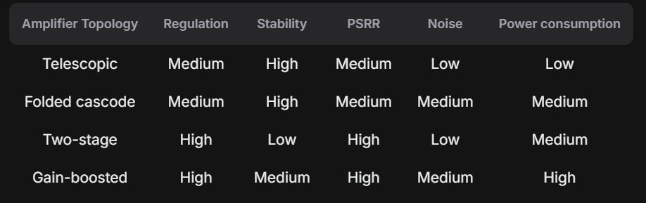
Comparison

Slide 23
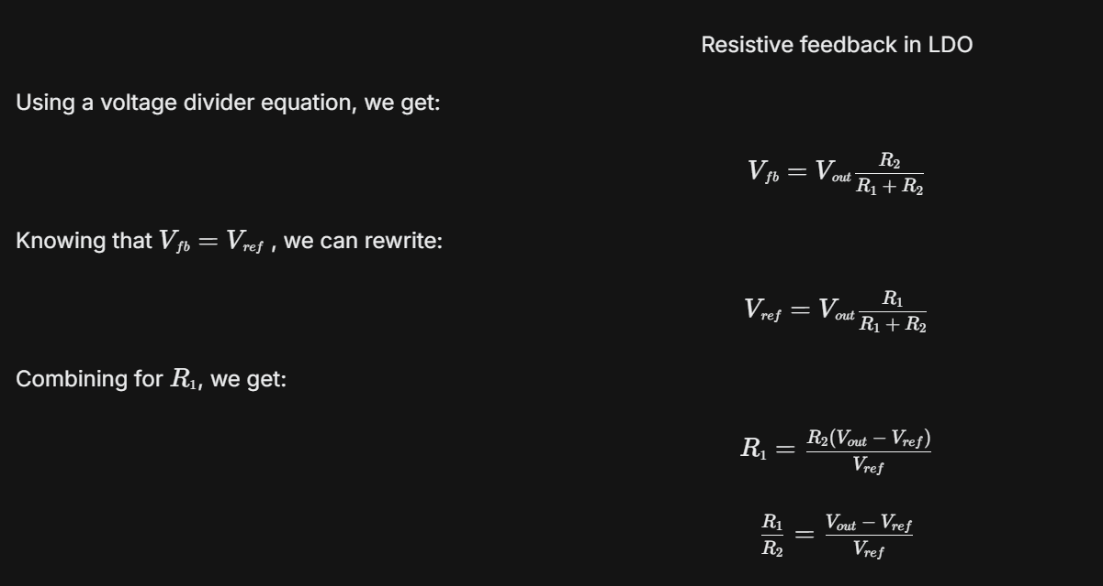
Feedback resistance calculation
The reference voltage is usually provided by the bandgap reference and usually outputs a fixed voltage, that might be different from what we want to see at the output of LDO. Solution to this is to use a voltage divider in the feedback of the LDO:

Slide 24
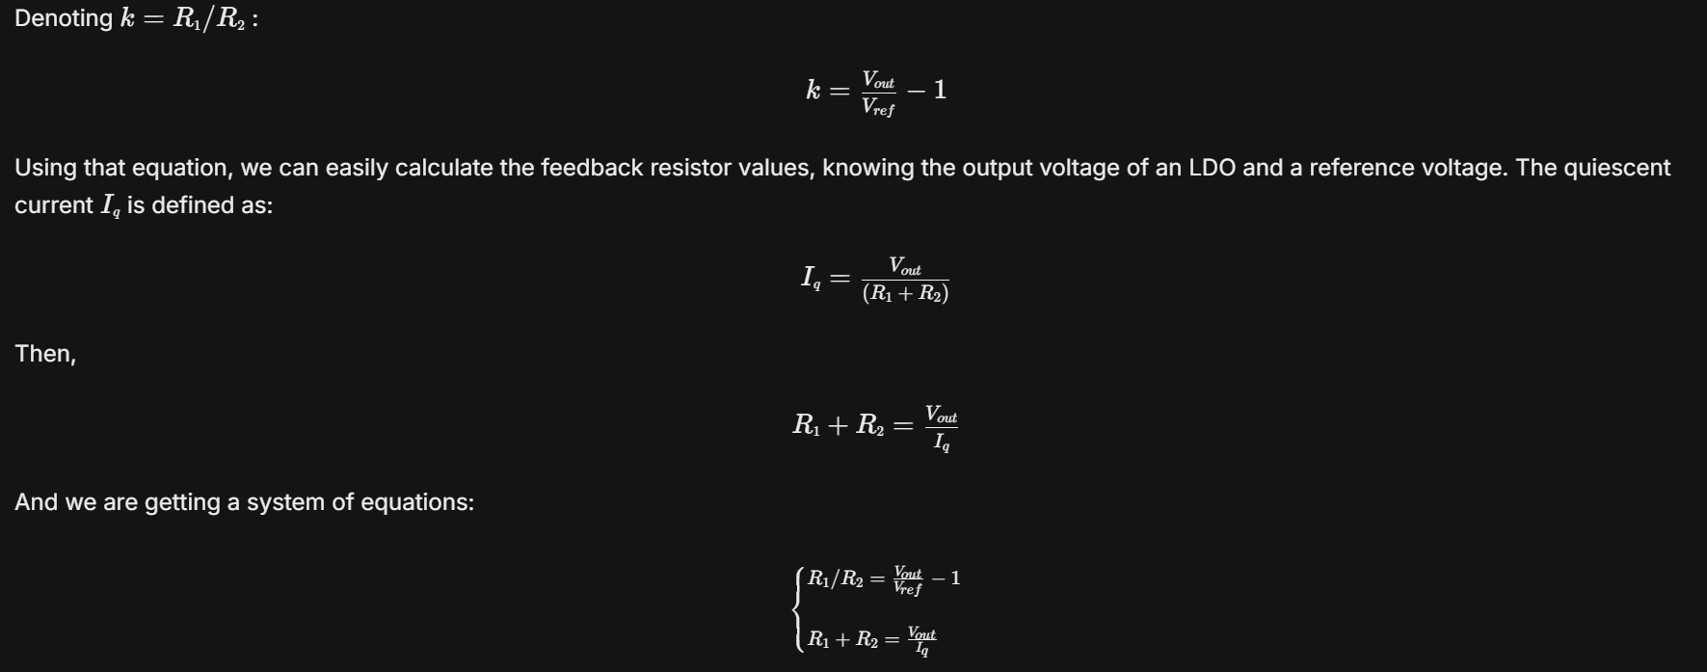
Cont..

Slide 25
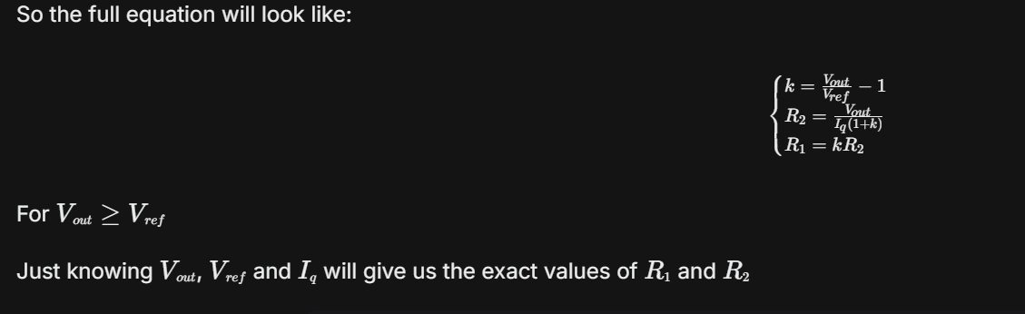
Cont..

Slide 26
Output voltage error
There are 3 main sources of the output error in LDO:
Voltage divider mismatch
  (R₁​ and R₂​)
  Gain error of error amplifier
  Reference voltage error

Slide 27
1. Voltage divider mismatch
The resistor value variation in CMOS process in generally big and can be up to 15-30%, depending on the resistor type.
Since only the ratio between R1​ and R2​ matters (and not their absolute values), we can neglect the error, introduced by the divider if we match them in layout.

Slide 28
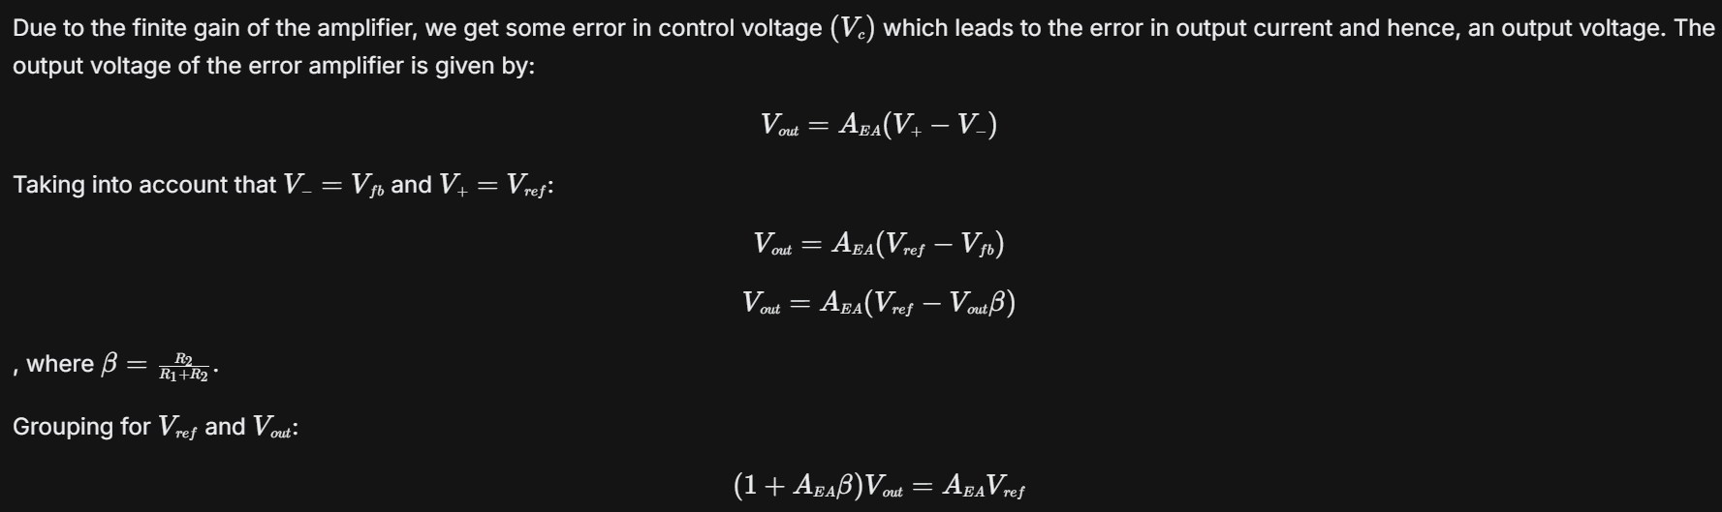
2 Gain error of error amplifier

Slide 29
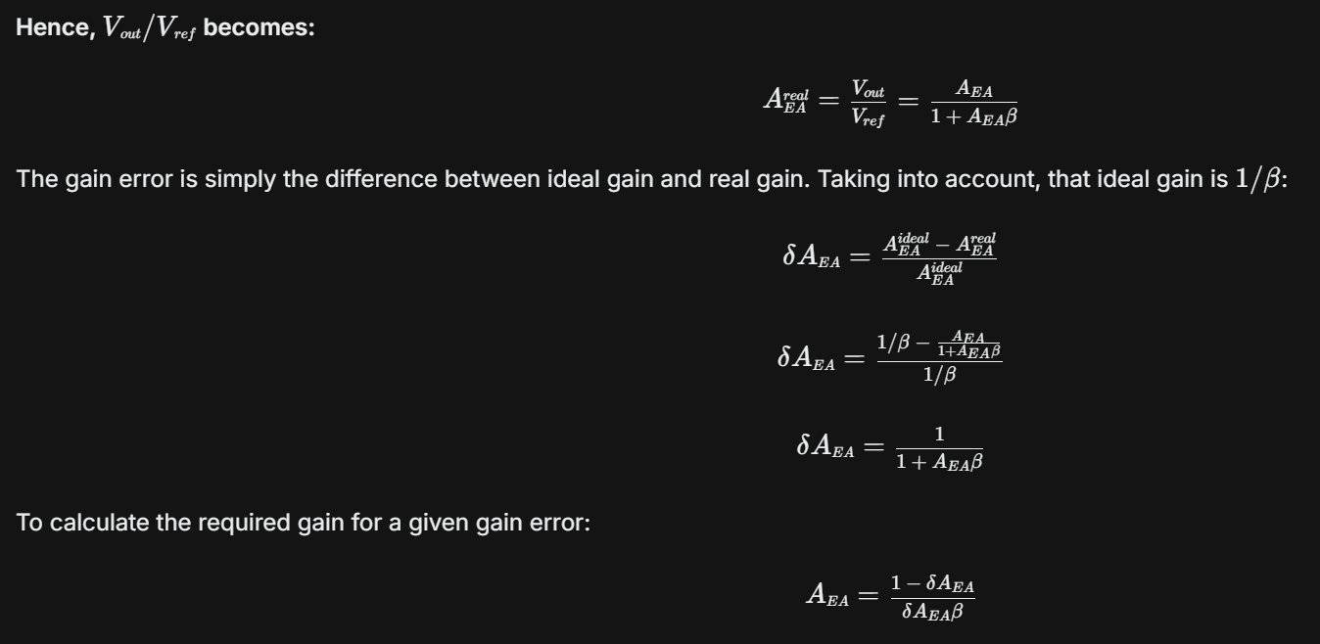
Cont..

Slide 30
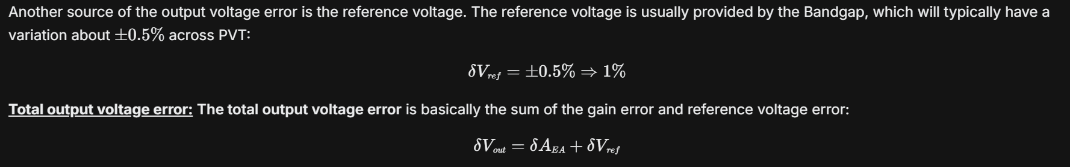
3 Reference voltage error

Slide 31
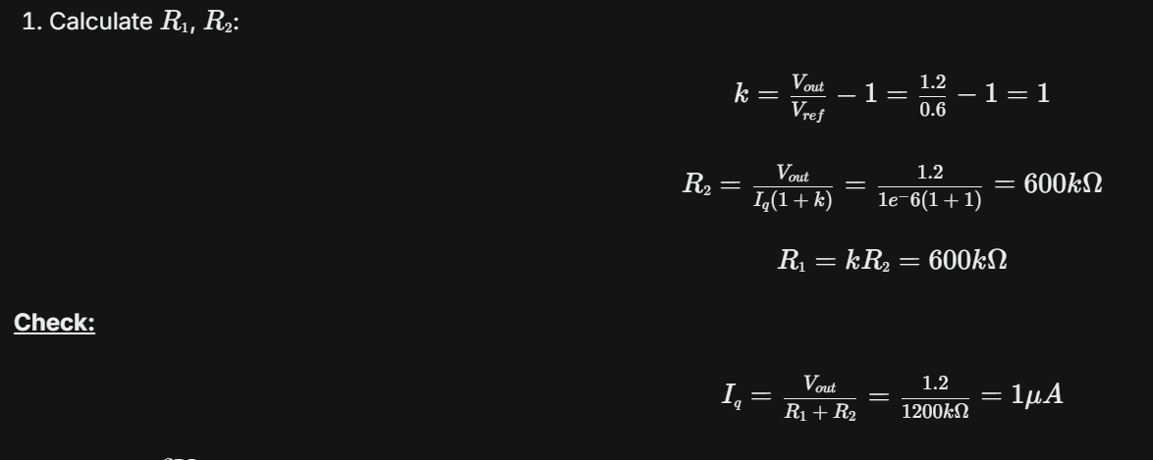
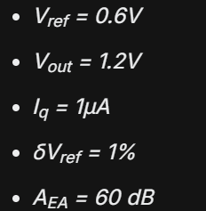
Calculation Example

Slide 32
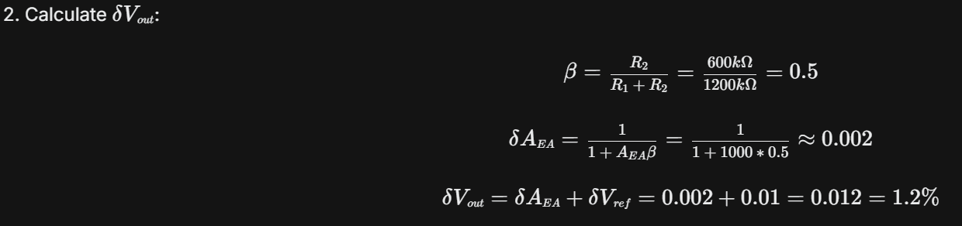
Cont..

Slide 33
Feedback Resistor Highlights
Use low-mismatch resistors, such as polysilicon resistors;
Make resistors as wide as possible to reduce mismatch;
Use unit-sized segments; connect resistors in parallel or in series, if needed;
Match feedback resistors in layout;
Total resistance defines quiescent current (Iq​) - a trade-off between stability and power consumption;

Slide 34
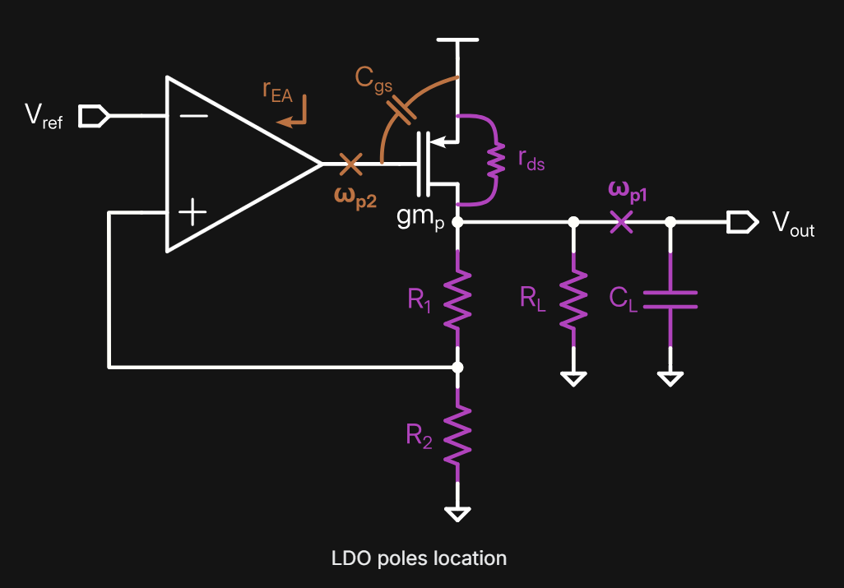
Stability & Transfer Function
As any feedback system, the LDO is a subject to stability analysis.
Let's dive into a typical LDO structure and understand the location and role of the poles and zeros.
In a typical LDO there are two main poles.

Slide 35
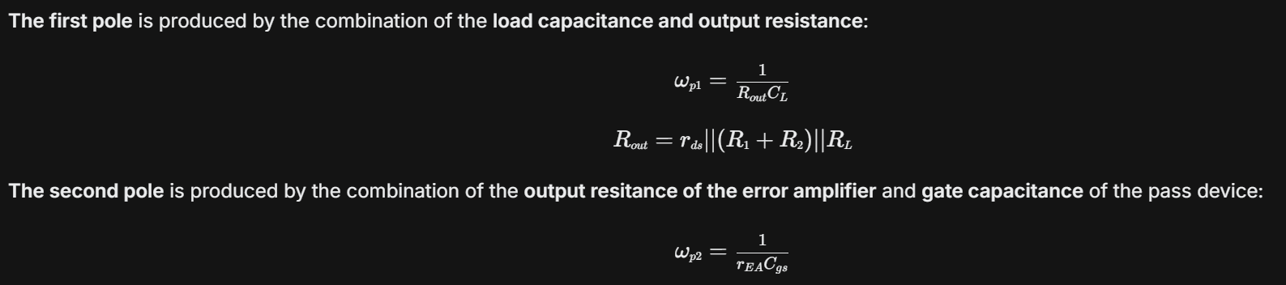
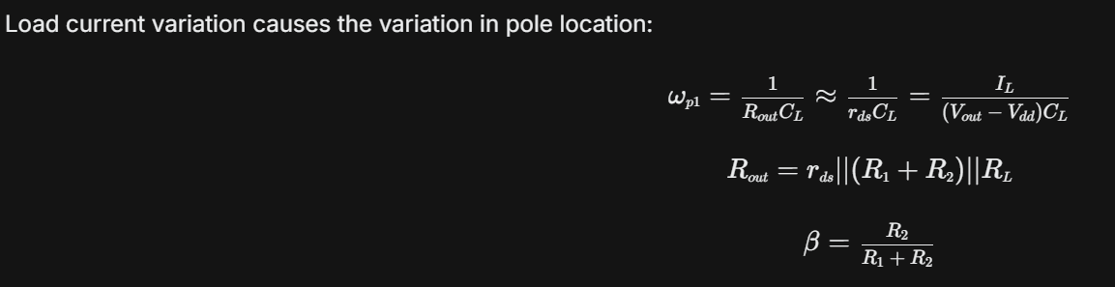
Cont..

Slide 36
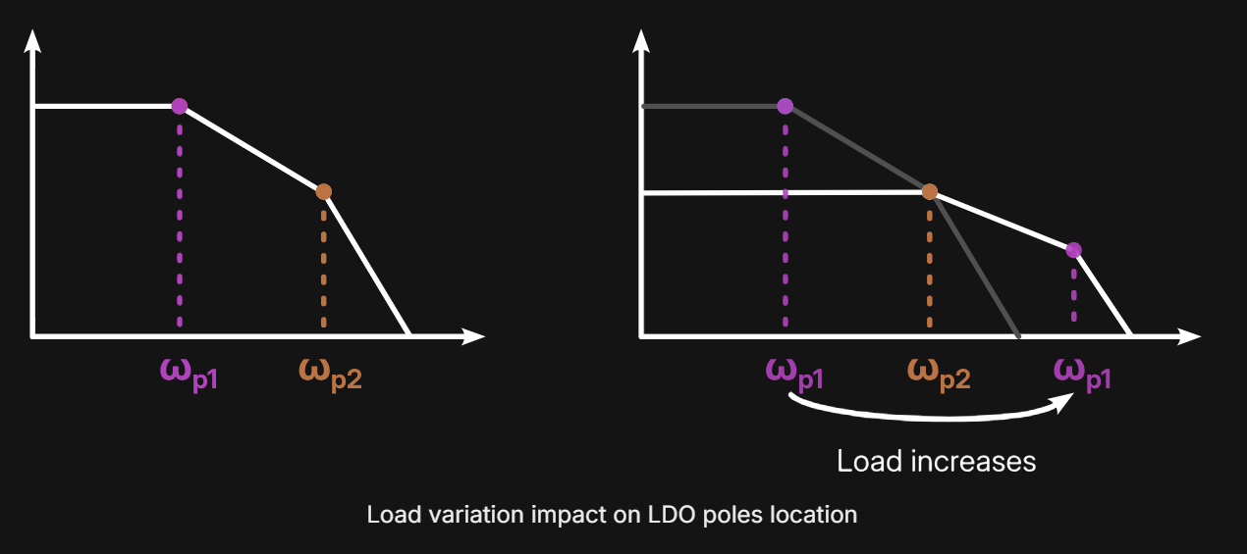
Cont..

Slide 37
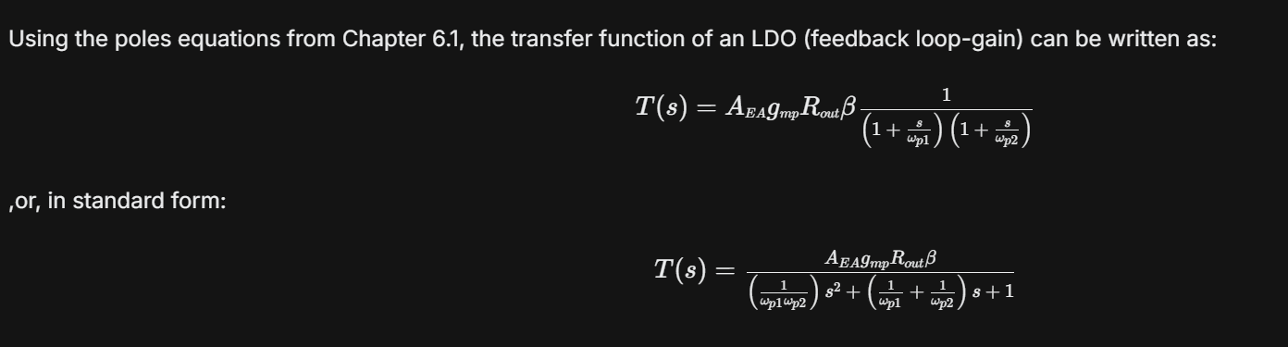
Transfer function of the LDO

Slide 38
Compensation
In the previous chapter we saw that the load pole ω_{p2}​ moves, when the load is changing. This effect lead to change in phase margin, which can lead to unstable condition (oscillations). There are two main ways to compensate this effect:
  Zero insertion
  C_{gs​} shielding through buffer

Slide 39
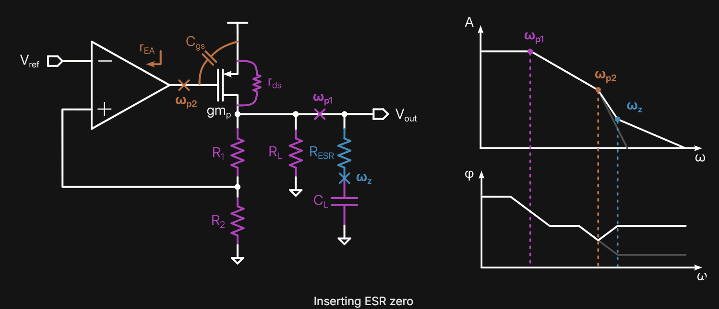
Using a ESR zero
One of the ways to compensate our LDO with external capacitor is to utilize the capacitor's equivalent series resistance (ESR). Every capacitor model contains the series resistance that represents the losses in the capacitor.

Slide 40
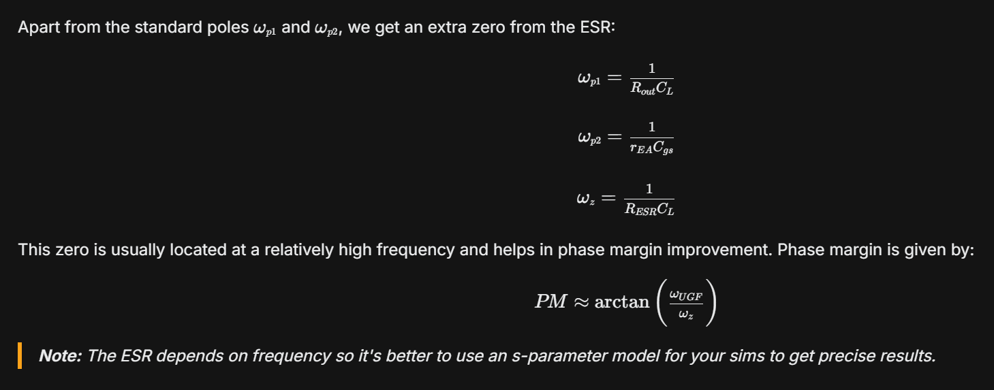
Cont..

Slide 41
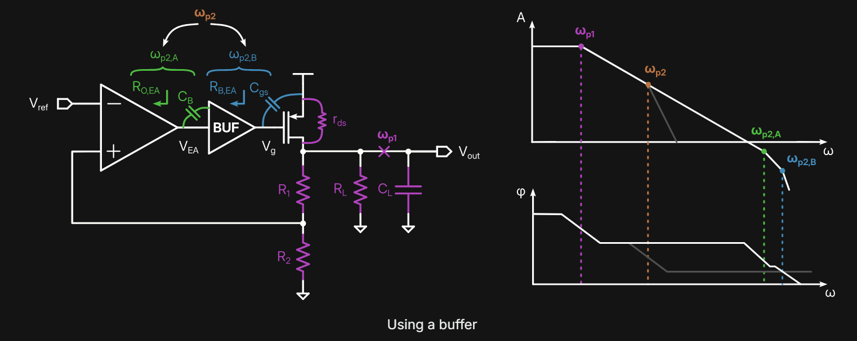
Using a buffer
Another way to compensate an LDO is to add a buffer between the output of the amplifier and the pass device. Effectively, adding a buffer will shield the output of the error amplifier from the large Cgs​ of the pass device

Slide 42
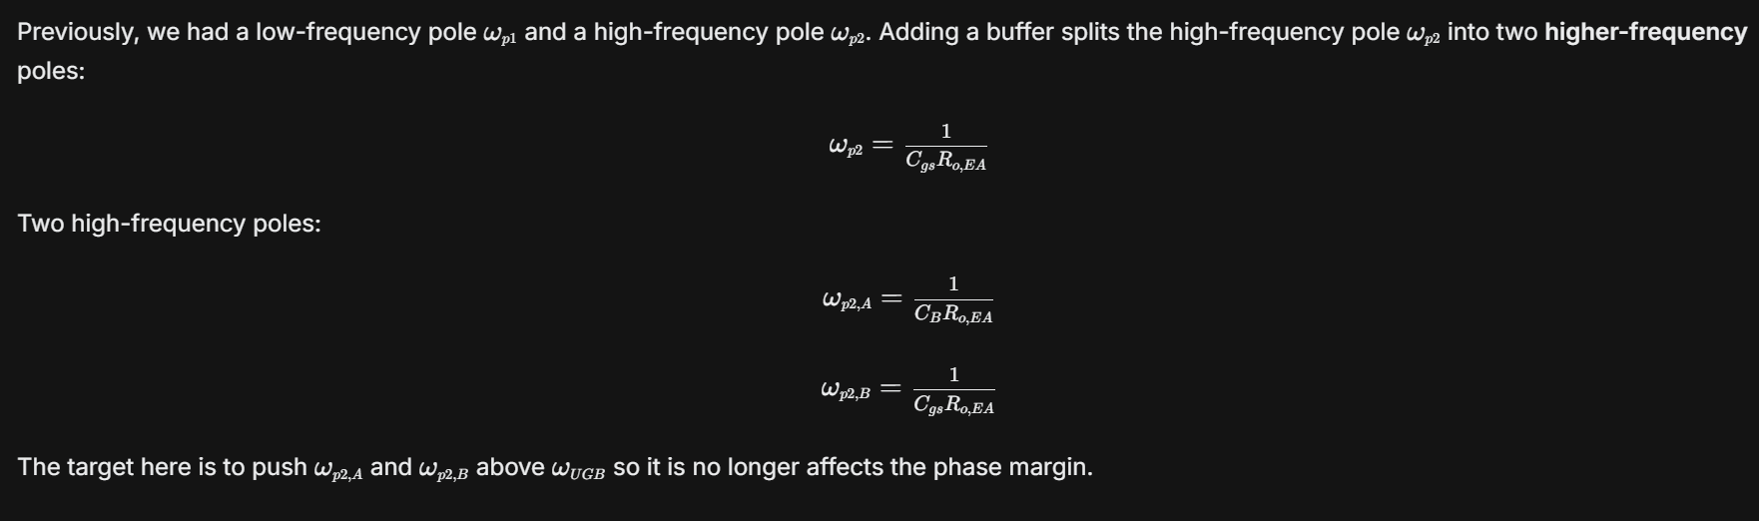
Cont..

Slide 43
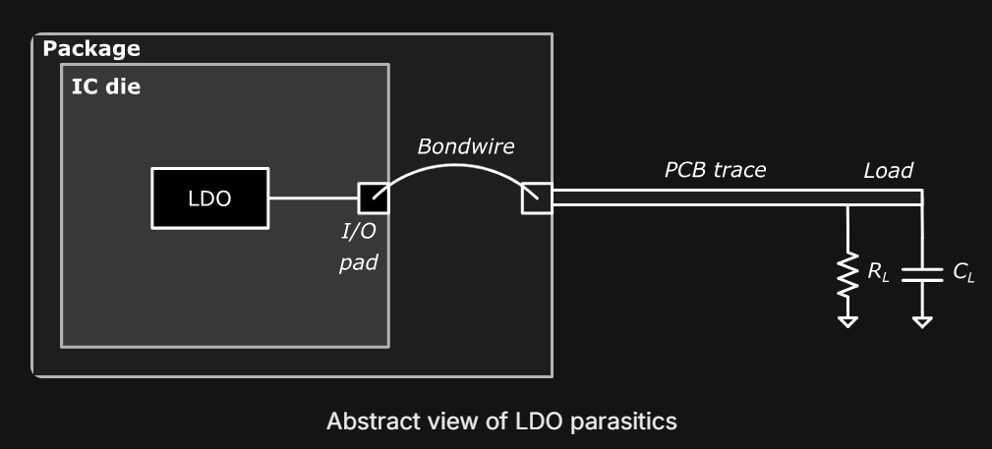
LDO Parasitics
In the design of LDO with an off-chip capacitor, it's very important to take into account parasitics, associated with the output node. The main contributors are I/O pads, bondwires, packaging and PCB trace:

Slide 44
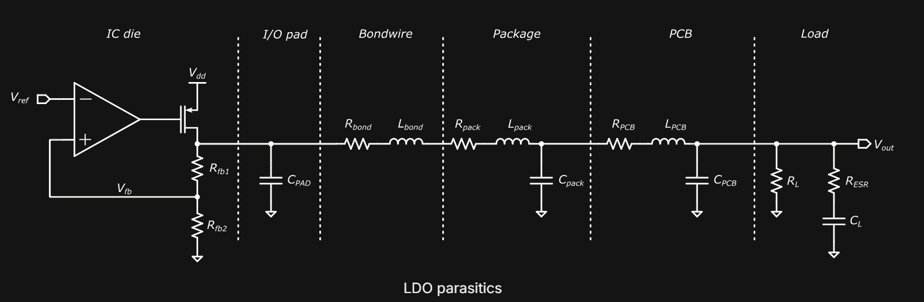
LDO Parasitics
Let's now have a detailed look into these contributors.
  The I/O pad is a large piece of metal so its contribution is mostly capacitive. The typical capacitance for the analog I/O pad is around 1-2pF and usually mentioned in the process documentation.
  The next piece is the bondwire - metal interconnect between the chip and package. Bondwires are typically made of gold to achieve low resistance (≈50mΩ/mm).
  However, due to relatively big length, the bondwire brings a significant inductance to the picture (≈1nH/mm) and it has to be taken into account.

Slide 45
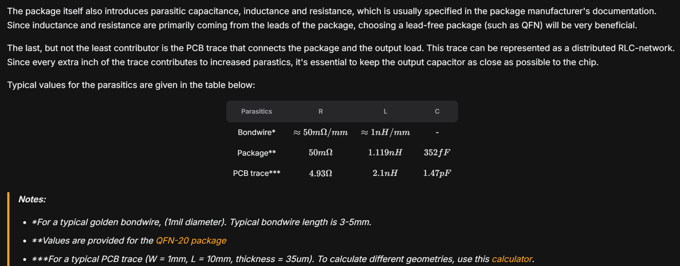
Cont..

Slide 46



Digital LDO
DAC = power-FET
ADC
control
^{V}in
^{V}in
Control
V
ref
V_{g}
V
ref
A
ADC
V_{g}[n-1:0]
^{V}out
^{V}out
^{R}load
^{C}out
^{R}load
^{C}out
Analog circuit-based feedback
Digital control, sandwiched by ADC and DAC
ADC: analog to digital converter, DAC: digital to analog converter

Slide 47
Digital LDO
A digital LDO replaces the traditional analog feedback loop with a digital feedback loop.
The idea: use digital control hardware as the controller, surrounded by:
  An ADC (to sense the voltage difference).
  A DAC implemented as a power-FET array (to regulate the output).
Operation flow:
  The ADC measures the difference between the reference voltage and the output voltage.
  It generates an error code proportional to this difference.
  The digital controller processes this error code and produces a digital output VgV_gVg​.
  Each bit of VgV_gVg​ drives one power transistor in the FET array, turning it ON or OFF.
  By adjusting how many FETs conduct, the effective resistance of the array changes, thereby regulating the output voltage toward the reference.
Similar to the analog case, a Cout capacitor is still required since the feedback speed of the digital LDO is not infinite.

Slide 48
Analog vs Digital LDOs
Digital LDO
Pros
Analog LDO
Pros
  High bandwidth for fast transient response
  High power supply rejection ratio (PSRR)
  Small output ripple
No major analog components and synthesizable control
Scales well for low-voltage operation
Decouples loop gain from operating voltage
Cons
  Complex/bulky analog design
  Limited scalability to low voltage
  Loop gain depends on operating voltage
Cons
Low bandwidth
Low PSRR
Large output ripple

Slide 49
Analog v/s Digital LDOs
Analog LDO – Advantages:
  High bandwidth → enables fast transient response.
  High PSRR (Power Supply Rejection Ratio) → effective noise suppression.
  Low output ripple → cleaner regulated voltage.
Analog LDO – Limitations:
  Requires bulky and complex analog circuit design.
  Scalability issues at low supply voltages.
  Loop gain depends on the input operating voltage.
Digital LDO – Advantages:
  No major analog components → fully synthesizable digital control.
  Well-suited for low supply voltage operation.
  Loop gain is independent of the input operating voltage.
Digital LDO – Limitations:
  Low bandwidth → slower transient response.
  Poorer PSRR compared to analog.
  Larger output ripple.

Slide 50



Input Voltage
Analog LDO:
The input voltage feeds both the power FET and the analog amplifier.
If the input voltage is too low, designing a high-performance amplifier becomes very difficult.
As a result, the minimum input voltage for analog LDOs is typically 0.6–0.7 V, and in some cases up to ~1 V.
Since the amplifier must also be high bandwidth, achieving this under low supply voltage is even more challenging.
· Digital LDO:
Contains no major analog components, so it is not constrained by amplifier design.
This gives better scalability with input voltage.
Digital LDOs can typically operate with input voltages as low as 0.5 V or even less.
Digital LDO
Analog LDO
^{V}in
^{V}in
Control
V
ref
V_{g}
A
V
ref
ADC
V_{g}[n-1:0]
^{V}out
^{V}out
^{R}load
^{C}out
^{R}load
^{C}out
Limited V_{in} scalability
Typically, V_{in} > 0.6-0.7V
A high-speed OP amplifier
Better V_{in} scalability
0.5V or less

Slide 51
Power-FET’s Source-Gate Voltage (V_{sg})
^{V}in
Analog LDO
Digital LDO
^{V}in
Control
V
ref
V_{g}
V
ref
A
ADC
V_{g}[n-1:0]
^{V}out
^{V}out
^{R}load
^{C}out
^{R}load
^{C}out
V_{sg}=V_{in}-V_{g} between V_{in}-V_{th} and 0V
i.e., V_{g} is analog voltage
V_{sg}=V_{in}-V_{g}: either 0V or V_{in}
i.e., V_{g} is digital voltage

Slide 52
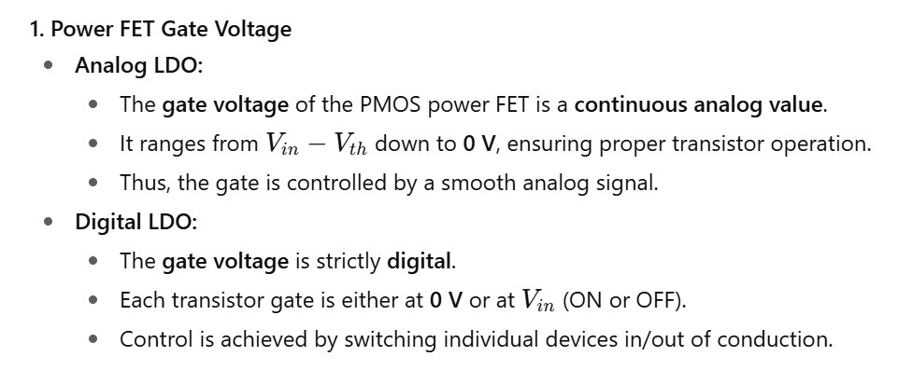
Deep Dive

Slide 53
Output Voltage
^{V}in
Analog LDO
Digital LDO
^{V}in
Control
0.05V~
V
ref
V_{g}
V
ref
A
0.2V~
ADC
V_{g}[n-1:0]
^{V}out
^{V}out
^{R}load
^{C}out
^{R}load
^{C}out
V_{out} = V_{in}–0.2V to ~0V
Power FET is typically in saturation
If a load needs V_{in}-0.1V, we supply V_{in}
V_{out} = V_{in}–0.05V to ~0V
Power FET is in linear to saturation
Wider output voltage range

Slide 54
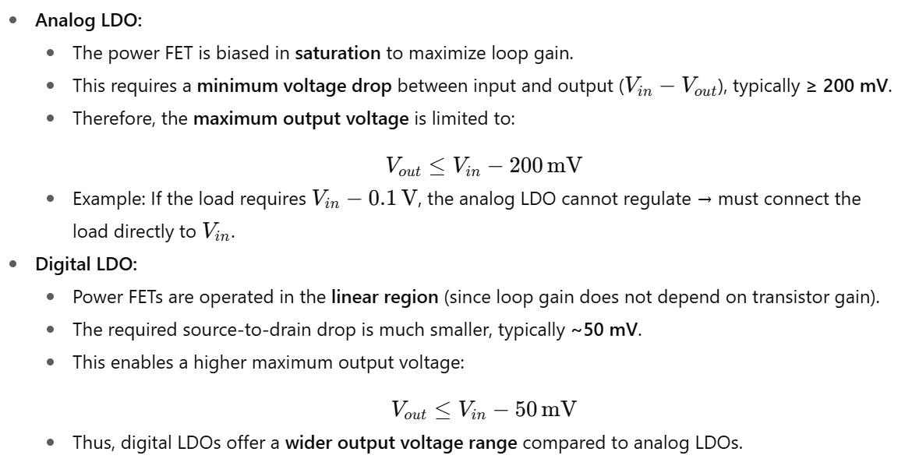
Output Voltage Range – Analog vs. Digital LDO

Slide 55
Dropout Voltage Requirement
V_{in}=0.6V
V_{in}=0.6V
0.1V
ALDO
ALDO
ALDO
0.2V
DLDO
DLDO
DLDO
0.2V
0.6V
Core
0.5V
Core
0.4V
Core
0.6V
Core
0.5V
Core
0.4V
Core
V_{in} set to the highest VDD requirement
An LDO can be bypassed
Less dropout voltage requirement
Support wider output voltage

Slide 56
Implication of Output Voltage Range in SoC Usage
Consider an SoC with three cores requiring:
  Core 1: 0.6 V
  Core 2: 0.5 V
  Core 3: 0.4 V
The input supply is set to the highest requirement, e.g. 0.6 V.
Analog LDO Case
Core 1 (0.6 V): Supplied directly from the input (no LDO needed).
Core 2 (0.5 V):
  Needs 100 mV lower than input.
  Analog LDO typically requires ~200 mV drop across the power FET (saturation).
  Therefore, it cannot regulate down to 0.5 V → must use 0.6 V directly.
  This results in power waste for this core.
Core 3 (0.4 V):
  Within the analog LDO regulation range.
  Can be supplied by an analog LDO.
Digital LDO Case
Core 1 (0.6 V): Direct supply.
Core 2 (0.5 V):
  Digital LDO has a much smaller required source-to-drain drop (~50 mV).
  Therefore, it can regulate from 0.6 V down to 0.5 V.
  Provides a better supply voltage match compared to analog LDO.
Core 3 (0.4 V): Also supported by digital LDO.

Slide 57
Key Specifications
Silicon area
Input, reference, and output voltage (V_{in}, V_{ref}, V_{out})
Edge time (t_{edge})
Voltage droop and overshoot (V_{droop}, V_{overshoot})
Response and settling time (t_{response,} t_{settle})
Load, quiescent, power-FET, and capacitor current (I_{load}, I_{q}, I_{pwr}, I_{cap})
Peak current and power efficiency (CE_{peak,} PE_{peak})
Dropout voltage (V_{dropout})
Power supply rejection ratio (PSRR)
Load regulation performance FoMs: ps FoM and pF FoM
Maximum and minimum load current (I_{load,max}, I_{load,min})
DAC and ADC number of bits (N_{DAC},N_{ADC})
Dead-zone voltage (V_{dz})
DAC step size (V_{DAC,ss})
IR drop voltage (V_{IR})

Slide 58
Silicon Area
· Why important?
In digital LDOs, silicon area is a critical factor since multiple LDOs are often integrated on a single chip.
· Area Breakdown (from recent publication):
Output capacitor → dominates, accounting for ~70% of the total area.
The remaining area is shared among:
  ADCs
  Digital controllers
  Power FETs
· Key Insight:
With technology scaling, active components (transistors, controllers, ADCs) shrink significantly.
Passive components (like capacitors) do not scale as effectively.
Thus, the output capacitor remains the major contributor to silicon area.
65-nm example [Kim-VLSI19]
ADC
V [n-1:0]
^{V}in
^{V}ref
g
ADC
ctrl
17.5%
9.6%
4.8%
Digital controller
^{V}out
68.1%
Power FETs
^{C}out
^{R}load
Output capacitor (100 pF)
Active components scale better than passive with technology scaling

Slide 59
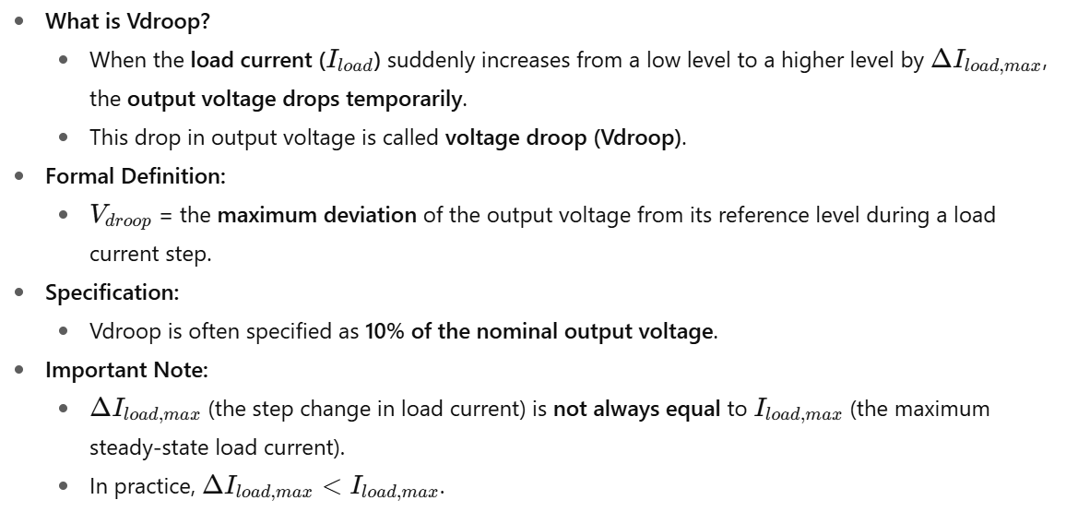
Voltage Droop (V_{droop})
^{ΔI}load,max
^{I}load
Time
^{V}out
^{V}droop
Time
V_{out}’s maximum downward
deviation from V_{ref}
V_{droop} is typically targeted to less than 10% of V_{out}
ΔI_{load,max} can be different ^{from I}load,max

Slide 60
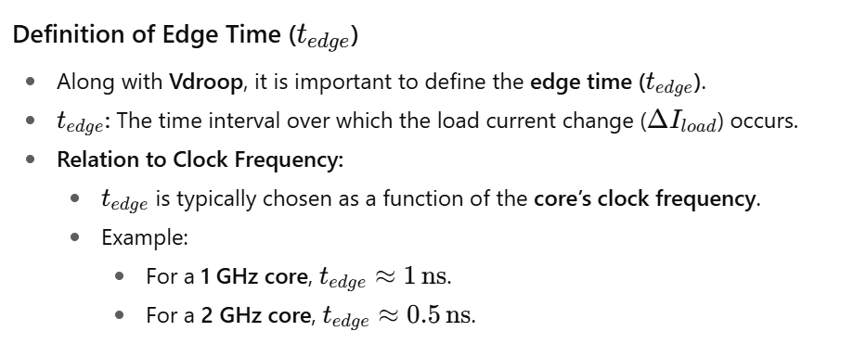
Edge Time (t_{edge})
^{t}edge
^{ΔI}load,max
^{I}load
Time
^{V}out
^{V}droop
Time
t is a function of the
edge
clock period of a load
1 GHz core → 1-ns t_{edge}
2 GHz core → 0.5-ns t_{edge}

Slide 61
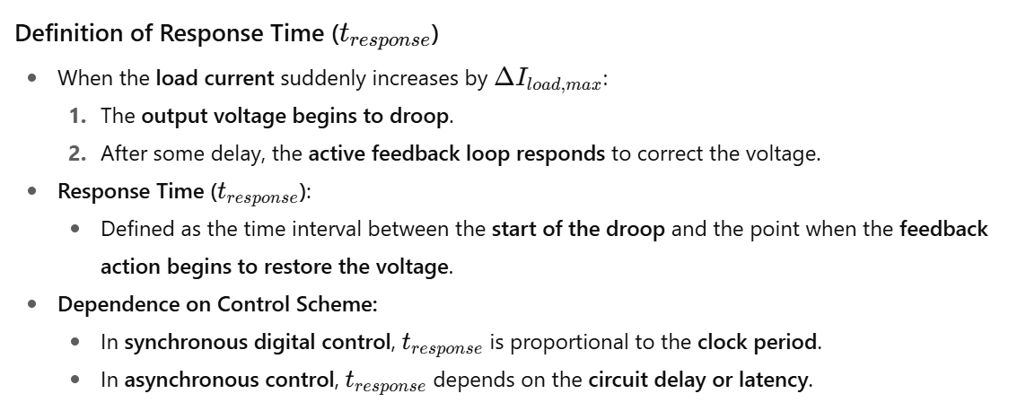
Response Time (t_{response})
^{ΔI}load,max
^{I}load
Time
^{V}out
Time
^{t}response
It is roughly proportional to feedback latency
In synchronous control, it is proportional to t_{clk}
In asynchronous control, it is proportional to circuit latency/delay

Slide 62
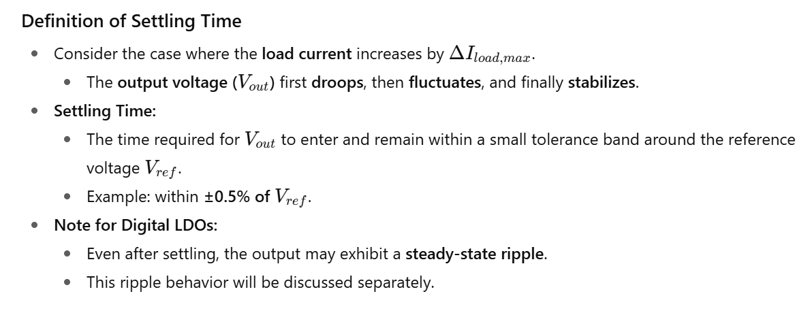
Settling Time (t_{settle})
^{ΔI}load,max
^{I}load
Time
1 LSB
^{V}out
^{t}settle
Time
Time to take for V_{out} to settle within less than a small % of V_{ref} (e.g., +/- 0.5%)
The output can have a ripple

Slide 63
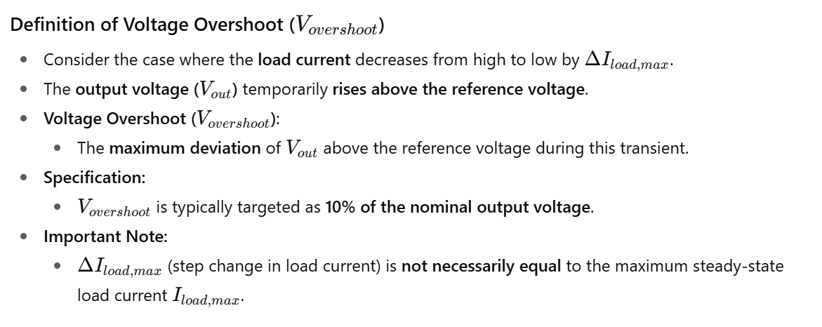
Voltage Overshoot (V_{overshoot})
^{ΔI}load,max
^{I}load
Time
^{V}out
V
overshoot
Time
V_{out}’s maximum upward
deviation from V_{ref}
V_{overshoot} is typically targeted to less than 10% of V_{out}
ΔI_{load,max} is different ^{from I}load,max

Slide 64
Current and Power Efficiency (CE, PE)
Quiescent current
Power FET current
I_{q}
^{V}in
^{𝐼}𝑙𝑜𝑎𝑑
^{I}pwr
𝐶𝐸 =
𝐼 + 𝐼
V
V_{g}
𝑞
𝑙𝑜𝑎𝑑
Total current
ref
ctrl
ADC
f
𝑃𝐸 =
^{𝑉}𝑜𝑢𝑡 .^{𝐼}𝑙𝑜𝑎𝑑
^{𝑉}𝑜𝑢𝑡
≈
s
^{𝑉}𝑖𝑛
^{V}out
^{I}cap
^{I}load
𝑉_{𝑖𝑛} ( 𝐼_{𝑞} + 𝐼_{𝑙𝑜𝑎𝑑})
^{C}out
^{R}load
If: I << I
Capacitor current
~0 in the steady state
q
load
Load current;
Equal to I_{pwr} in the steady state

Slide 65


Slide 66
Current Efficiency vs. Peak Current Efficiency
CE
𝐶𝐸 =
^{𝐼}𝑙𝑜𝑎𝑑
^{𝐼}𝑞 ^{+ 𝐼}𝑙𝑜𝑎𝑑
99.999%
99.99%
𝐼
CE_{peak}=99.9%
^{𝐶𝐸}𝑝𝑒𝑎𝑘 ⁼
𝑙𝑜𝑎𝑑, 𝑚𝑎𝑥
^{𝐼}𝑞 ^{+ 𝐼}𝑙𝑜𝑎𝑑,𝑚𝑎𝑥
log(I )
1 |  | 1 |  | 1 |  | 1
10,000 |  | 1000 |  | 100 |  | 10
load
1
99.9% CE_{peak}
99.999% CE_{peak}
→ 1% or less loss for I_{load} = 0.1∙I_{load,max} to I_{load,max}
→ 1% or less loss for I_{load} = 0.001∙I_{load,max} to I_{load,max}

Slide 67

Cont..

Slide 68
Dropout Voltage (V_{dropout})
I_{q}
^{V}in
^{𝐼}𝑙𝑜𝑎𝑑
^{I}load
𝐶𝐸 =
𝐼 + 𝐼
V
ref
V_{g}
𝑞
𝑙𝑜𝑎𝑑
ADC
ctrl
^{V}dropout
𝑃𝐸 =
^{𝑉}𝑜𝑢𝑡 ^{𝐼}𝑙𝑜𝑎𝑑
^{𝑉}𝑜𝑢𝑡
≈
𝑉_{𝑖𝑛} (𝐼_{𝑞} + 𝐼_{𝑙𝑜𝑎𝑑})
^{𝑉}𝑖𝑛
^{V}out
C
R
^{𝑉}𝑖𝑛 ^{− 𝑉}𝑑𝑟𝑜𝑝𝑜𝑢𝑡 ^{𝑉}𝑑𝑟𝑜𝑝𝑜𝑢𝑡
= = 1 −
out
load
𝑉 𝑉
𝑖𝑛 𝑖𝑛
The larger dropout voltage, the lower PE

Slide 69
Power Supply Rejection Ratio (PSRR)
^{∆𝑉}𝑜𝑢𝑡
𝑃𝑆𝑅𝑅 = 20 log
[𝑑𝐵]
∆𝑉_{𝑖𝑛}
Hz
PSRR
Active Feedback
output capacitor

Slide 70

ps Figure of Merit (ps-FoM)
Pseudo response time
𝑝𝑠 𝐹𝑜𝑀 = 𝑡
^{𝐶}𝑜𝑢𝑡 . ^{∆𝑉}𝑜𝑢𝑡
∙
𝐼_{𝑞}
𝑟𝑒𝑠𝑝𝑜𝑛𝑠𝑒
∆𝐼
∆𝐼
𝑙𝑜𝑎𝑑, 𝑚𝑎𝑥
𝑙𝑜𝑎𝑑, 𝑚𝑎𝑥
Pseudo current efficiency
Dynamic load regulation performance
This FoM aims to capture the product of the LDO response time and current efficiency
Smaller is better
[Hazucha-JSSC05]

Slide 71


Caveats for the ps-FoM
* measurement Dropout=10% • V_{IN}
300
275
250
225
200
175
150
125
100
75
50
3
□
^{V}in^{, t}edge, ^{and ΔI}load,max ^{have a} strong impact on FoM.
V_{IN}=1V, ΔI_{LOAD}=407.7mA
V_{IN}=0.5V, ΔI_{LOAD}=91.8mA
ps FoM favors large ΔI_{load,max}
V = 1V
2
FOM (in Table I) [ps]
(∵ 𝑝𝑠 𝐹𝑜𝑀 ∝ Δ𝑉_{𝑜𝑢𝑡}/Δ𝐼² )
𝑙𝑜𝑎𝑑,𝑚𝑎𝑥
IN
V = 0.5V
V_{DROOP} [mV]
IN
Using a large output capacitor and proportionally increasing ΔI_{load,max} improves ps FoM in a same design
V_{IN}= 0.5V
1
V = 1V
□
^{Note ΔI}load,max^{, not I}load,max
IN
0
0 2 4 6 8 10 12 14 16 18 20 22 24 26 28 30
Ideal to compare designs having similar V_{in}, t_{edge}, and ΔI_{load,max}
T_{EDGE} [ns]
[Kim-VLSI19]

Slide 72
pF Figure of Merit (pF-FoM)
𝑝𝐹 𝐹𝑜𝑀 = 𝐼
^{∆𝑉}𝑜𝑢𝑡
𝐶
𝑞
∆𝐼
𝑙𝑜𝑎𝑑, 𝑚𝑎𝑥
^{𝑉}𝑜𝑢𝑡
𝑜𝑢𝑡
Normalized voltage droop
Alternative FoM for dynamic load regulation performance
How small the voltage droop is at the power (I_{q}) and area cost (C_{out})
Smaller is better
pF FoM works better to compare LDOs with different ΔI_{load,max}
Should use it for designs having similar V_{in} and t_{edge}
[Kim-JSSC17]

Slide 73

Maximum Load Current (I_{load,max})
𝑃𝑜𝑤𝑒𝑟 𝐹𝐸𝑇 𝑢𝑛𝑖𝑡 𝑐𝑢𝑟𝑟𝑒𝑛𝑡 = 𝐼
If power FETs are sized in the power of 2
𝑢
𝑀𝑎𝑥𝑖𝑚𝑢𝑚 𝑙𝑜𝑎𝑑 𝑐𝑢𝑟𝑟𝑒𝑛𝑡
^{𝐼}𝑙𝑜𝑎𝑑, 𝑚𝑎𝑥

Slide 74

DAC Number of Bits (N_{DAC})
𝑃𝑜𝑤𝑒𝑟 𝐹𝐸𝑇 𝑢𝑛𝑖𝑡 𝑐𝑢𝑟𝑟𝑒𝑛𝑡 = 𝐼
If power FETs are sized in the power of 2
𝑢
𝑀𝑎𝑥𝑖𝑚𝑢𝑚 𝑙𝑜𝑎𝑑 𝑐𝑢𝑟𝑟𝑒𝑛𝑡
^{𝐼}𝑙𝑜𝑎𝑑, 𝑚𝑎𝑥
𝐼
= 𝐼 (2^{𝑁𝐷AC} − 1)
𝑁_{𝐷𝐴𝐶} = log₂(
^{𝐼}𝑙𝑜𝑎𝑑, 𝑚𝑎𝑥 ₊ ₁₎
𝑙𝑜𝑎𝑑, 𝑚𝑎𝑥
𝑢
𝐼
𝑢

Slide 75
DAC Step Size (V_{DAC,SS})
𝑃𝑜𝑤𝑒𝑟 𝐹𝐸𝑇 𝑢𝑛𝑖𝑡 𝑐𝑢𝑟𝑟𝑒𝑛𝑡 = 𝐼
If power FETs are sized in the power of 2
𝑢
𝑀𝑎𝑥𝑖𝑚𝑢𝑚 𝑙𝑜𝑎𝑑 𝑐𝑢𝑟𝑟𝑒𝑛𝑡
^{𝐼}𝑙𝑜𝑎𝑑, 𝑚𝑎𝑥
𝐼
= 𝐼 (2^{𝑁𝐷AC} − 1)
𝑁_{𝐷𝐴𝐶} = log₂(
^{𝐼}𝑙𝑜𝑎𝑑, 𝑚𝑎𝑥 ₊ ₁₎
𝑙𝑜𝑎𝑑, 𝑚𝑎𝑥
𝑢
𝐼
𝑢
Output voltage resolution (worst-case)
^{𝑉}𝐷𝐴𝐶, 𝑆𝑆 ^{= 𝐼}𝑢 .^{𝑅}𝑙𝑜𝑎𝑑,𝑚𝑎𝑥

Slide 76
Minimum Load Current (I_{load,min})
𝑃𝑜𝑤𝑒𝑟 𝐹𝐸𝑇 𝑢𝑛𝑖𝑡 𝑐𝑢𝑟𝑟𝑒𝑛𝑡 = 𝐼
If power FETs are sized in the power of 2
𝑢
𝑀𝑎𝑥𝑖𝑚𝑢𝑚 𝑙𝑜𝑎𝑑 𝑐𝑢𝑟𝑟𝑒𝑛𝑡
^{𝐼}𝑙𝑜𝑎𝑑, 𝑚𝑎𝑥
𝐼
= 𝐼 (2^{𝑁𝐷AC} − 1)
𝑁_{𝐷𝐴𝐶} = log₂(
^{𝐼}𝑙𝑜𝑎𝑑, 𝑚𝑎𝑥 ₊ ₁₎
𝑙𝑜𝑎𝑑, 𝑚𝑎𝑥
𝑢
𝐼
𝑢
Output voltage resolution (worst-case)
r=0.01 if targeting ^{V}DAC,SS^{=1% of V}out
^{𝑉}𝐷𝐴𝐶, 𝑆𝑆 ^{= 𝐼}𝑢 .^{𝑅}𝑙𝑜𝑎𝑑,𝑚𝑎𝑥
= 𝐼 .
^{𝑉}𝑜𝑢𝑡
= 𝐼 .
^{𝑉}𝑜𝑢𝑡
= 𝑟 .𝑉
𝑢
^{𝐼}𝑙𝑜𝑎𝑑,𝑚𝑖𝑛
𝑢
1/
𝐼
𝑜𝑢𝑡
𝑟 𝑢

Slide 77
Minimum Load Current (I_{load,min})
𝑃𝑜𝑤𝑒𝑟 𝐹𝐸𝑇 𝑢𝑛𝑖𝑡 𝑐𝑢𝑟𝑟𝑒𝑛𝑡 = 𝐼
If power FETs are sized in the power of 2
𝑢
𝑀𝑎𝑥𝑖𝑚𝑢𝑚 𝑙𝑜𝑎𝑑 𝑐𝑢𝑟𝑟𝑒𝑛𝑡
^{𝐼}𝑙𝑜𝑎𝑑, 𝑚𝑎𝑥
𝐼
= 𝐼 (2^{𝑁𝐷AC} − 1)
𝑁_{𝐷𝐴𝐶} = log₂(
^{𝐼}𝑙𝑜𝑎𝑑, 𝑚𝑎𝑥 ₊ ₁₎
𝑙𝑜𝑎𝑑, 𝑚𝑎𝑥
𝑢
𝐼
𝑢
Output voltage resolution (worst-case)
r=0.01 if targeting ^{V}DAC,SS^{=1% of V}out
^{𝑉}𝐷𝐴𝐶, 𝑆𝑆 ^{= 𝐼}𝑢 .^{𝑅}𝑙𝑜𝑎𝑑,𝑚𝑎𝑥
= 𝐼 .
^{𝑉}𝑜𝑢𝑡
= 𝐼 .
^{𝑉}𝑜𝑢𝑡
= 𝑟 .𝑉
𝑢
^{𝐼}𝑙𝑜𝑎𝑑,𝑚𝑖𝑛
𝑢
1/
𝐼
𝑜𝑢𝑡
𝑟 𝑢
𝐼
= 𝐼 .
^{𝑉}𝑜𝑢𝑡
= 𝐼 .
^{𝑉}𝑜𝑢𝑡
𝐼
𝑢
𝑙𝑜𝑎𝑑,𝑚𝑖𝑛
𝑢
𝑢
𝑟 . . 𝑉_{𝑜𝑢𝑡} 𝑟
= ≫ 𝐼
𝑢
^{𝑉}𝐷𝐴𝐶,𝑆𝑆
e.g., I
load,min
=100·I
u
for r=0.01

Slide 78

Clock Frequency (f_{clk})
^{V}in
^{V}ref
V_{g}
ADC
ctrl
Clk
Clk
^{V}out
^{C}out
^{R}load
Clock for a synchronous ADC and a controller
High clock frequency (f_{clk}) improves t_{response}, t_{settle}, V_{droop}, and V_{overshoot}
High f_{clk} increases I_{q}, thus degrading CE

Slide 79
Output Ripple Size (V_{ripple})
^{V}in
^{V}ref
V_{g}
ADC
ctrl
Clk
Clk
The controller output alternates between two codes with 1 LSB difference
V
out
^{C}out
R
load
^{V}ripple
≅ α ∙ I_{u} ∙ R_{load} , , where α = 1 for f_{clk} ≪ _{V}
^{I}𝑙𝑜𝑎𝑑 ,𝑚𝑖𝑛
C
out out
High f_{clk} increases V_{ripple}
Because a controller makes a correction before the previous correction is fully applied on a load [Nasir-TPE16]

Slide 80
Output Ripple Size (V_{ripple})
^{V}ripple
≅ α ∙ I_{u} ∙ R_{load} , , where α = 1 for f_{clk} ≪ _{V}
^{I}𝑙𝑜𝑎𝑑 ,𝑚𝑖𝑛
C
out out
*Simulation
Vin=0.55V, Vout=0.45V
25
V_{ripple} is also a function of
80°C
temperature &
^{I}load
20
α=1, IU=6nA, 11-bit power-FET array
[mV]
15
Worst-case V_{ripple}
@ I_{load,min} and high temperature
^{V}ripple
24°C
10
5
0°C
0
100 1,000 10,000
I_{load} [nA]
Source: S.J. Kim (Columbia)

Slide 81




IR Drop (V_{IR})
^{V}in
^{V}ref
^{I}load
ADC
Ctrl
^{Rpara V}out,far
Time
^{V}out
^{I}load
V
C
out
^{R}load
^{V}out
IR
^{𝑉}𝐼𝑅 ^{= 𝑅}𝑝𝑎𝑟𝑎 ^{� 𝐼}𝑙𝑜𝑎𝑑
Time
Parasitic resistance (R_{para}) can make V_{out} ≠ V_{out,far}
The ADC senses V_{out}, not V_{out,far}
This deviation, V_{IR}, grows with I_{load}

